Slide 1


Key words:
Crater | Sediment | Apparatus

Slide 2



The Fateful Night
After the torpedo struck on the night of 16th February 1941, the SS Gairsoppa plummeted down through the sea for about five and a half minutes at a speed of thirty miles per hour.

Slide 3
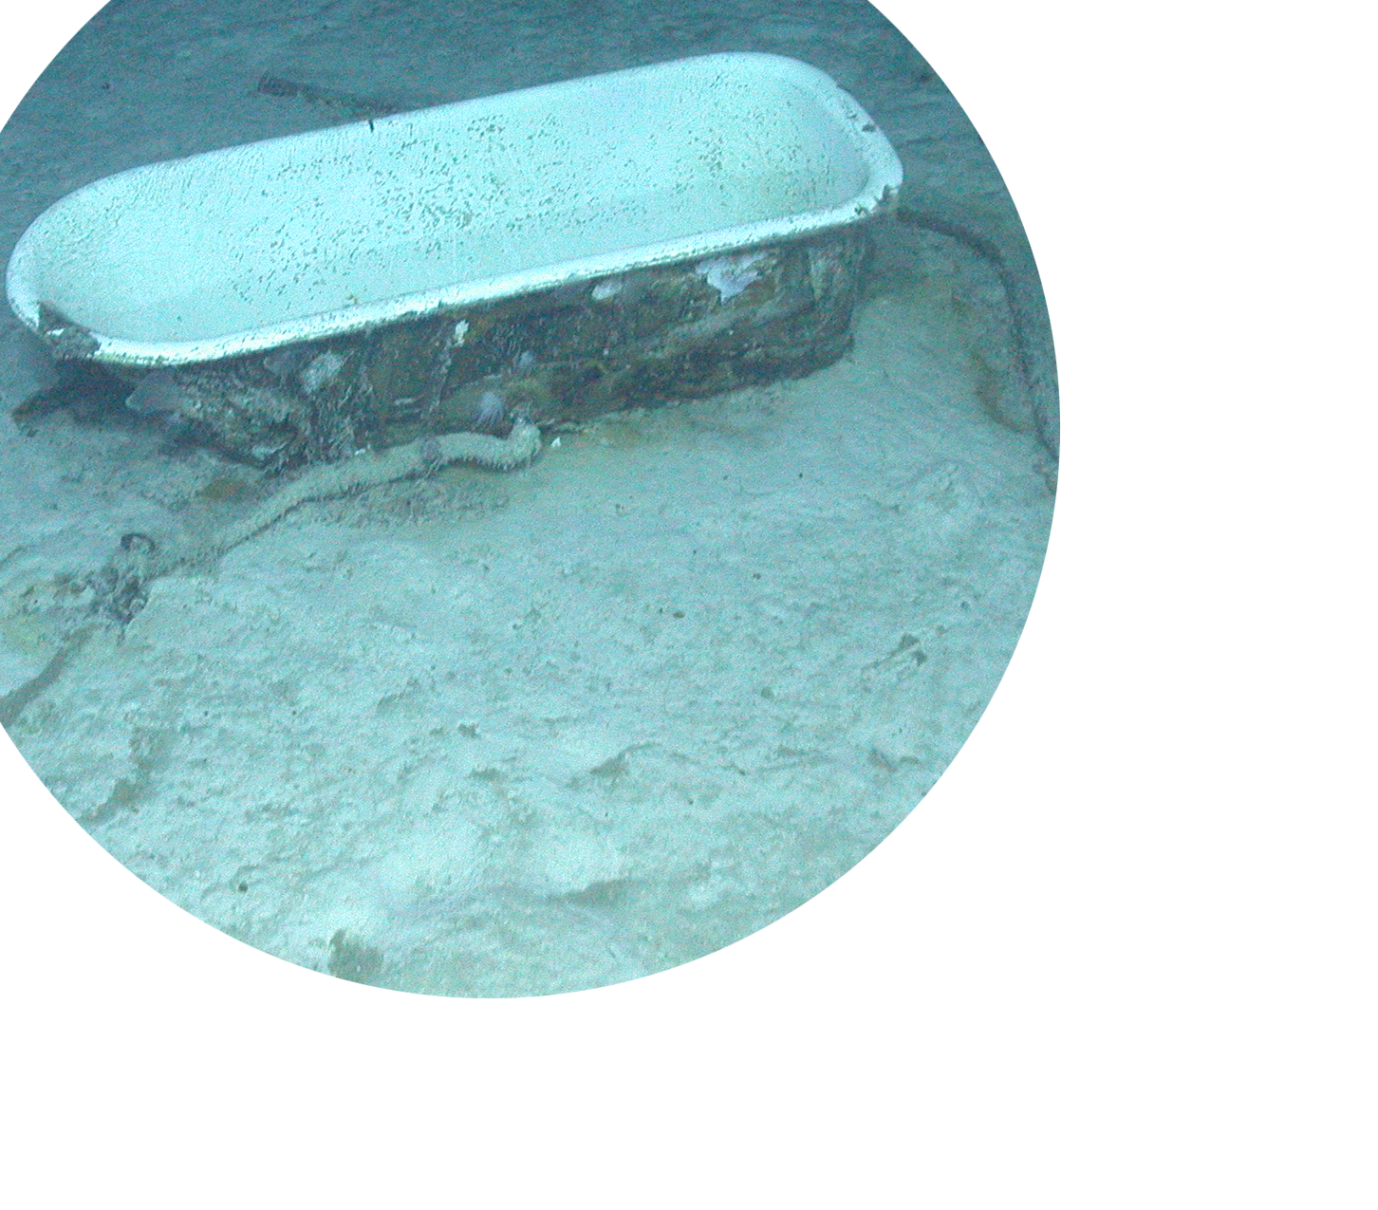

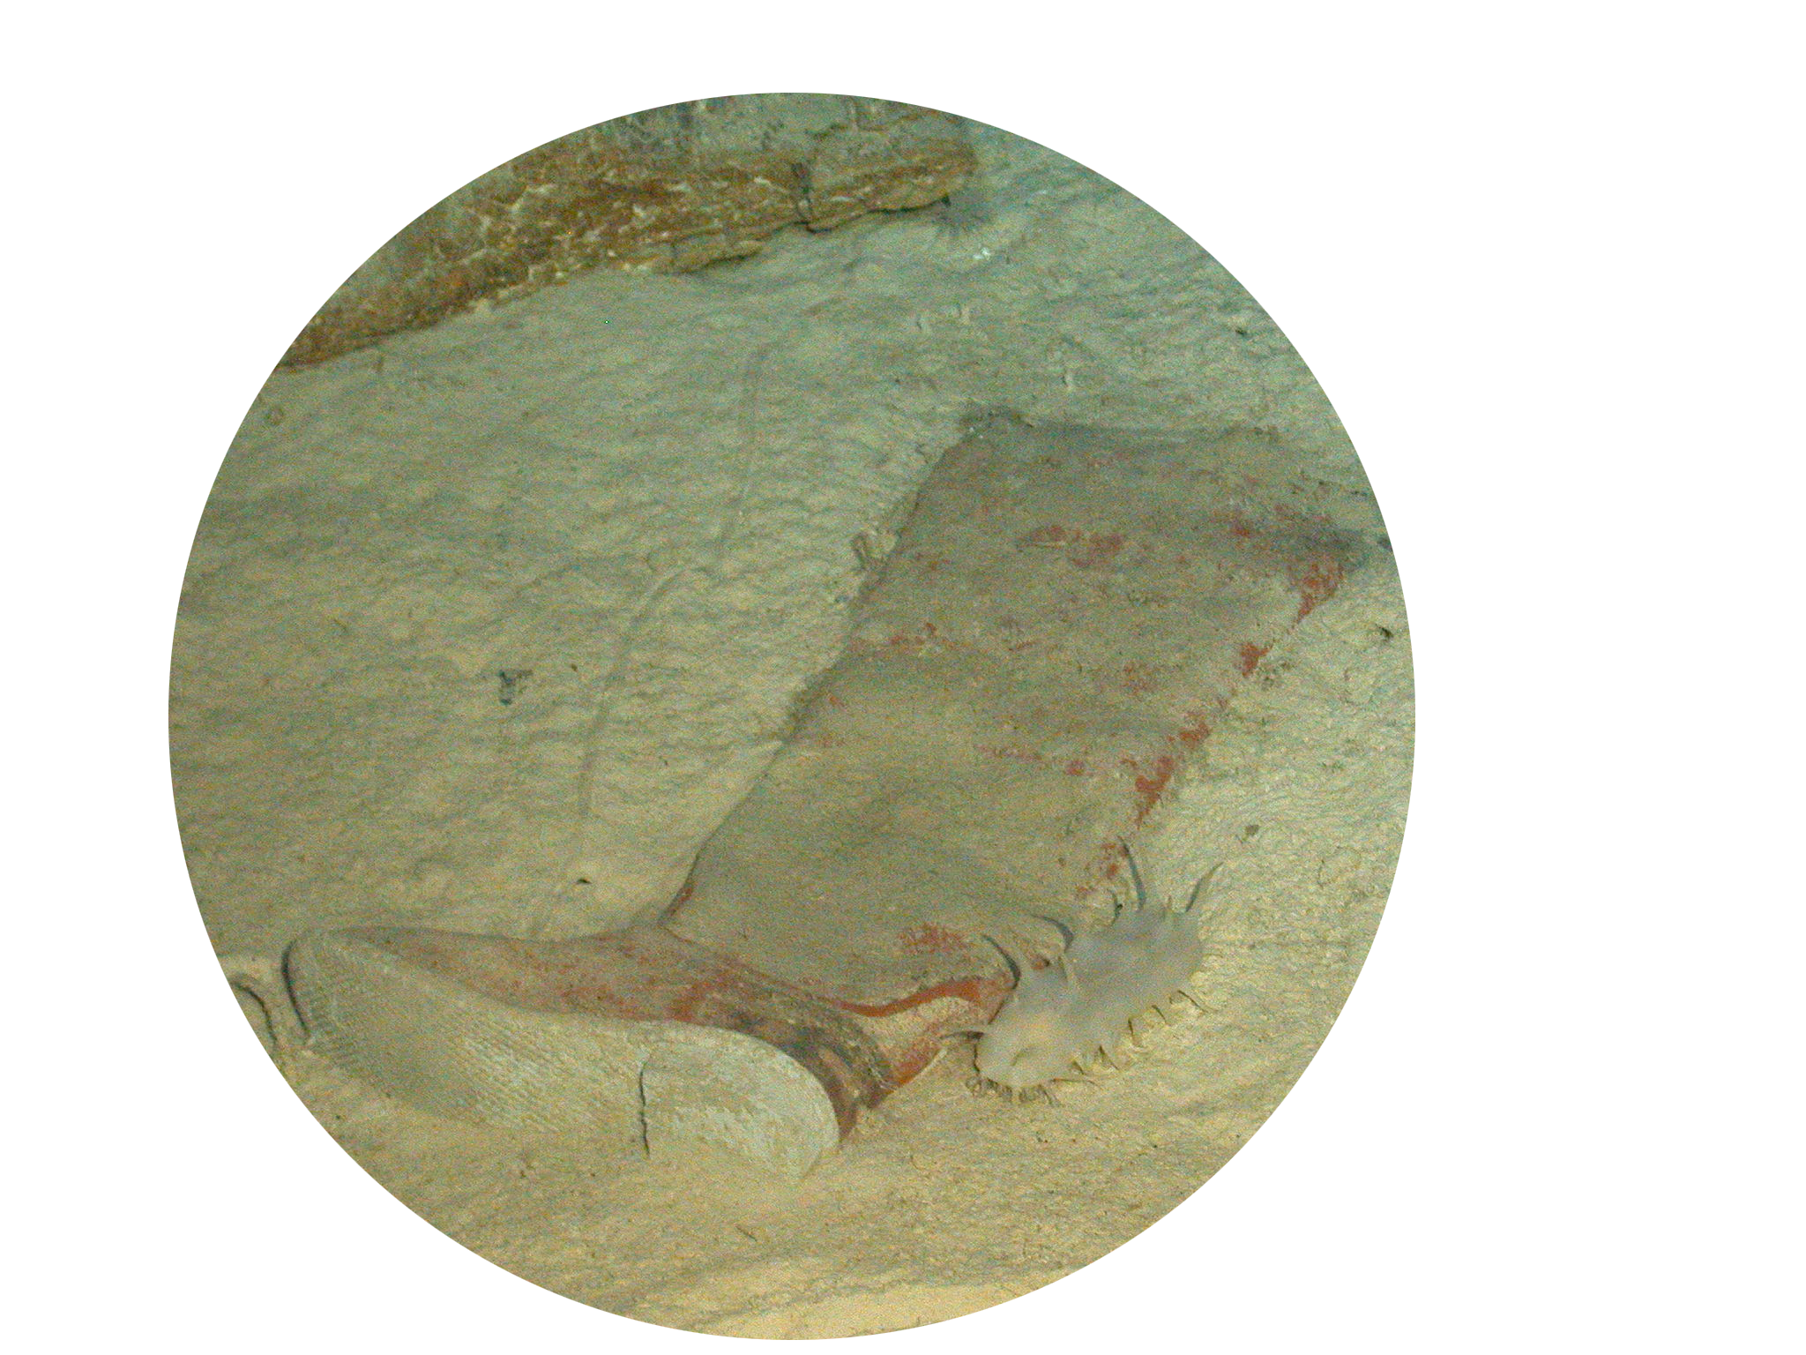
Loose objects were sucked out of the ship as the air escaped and lie scattered all around the wreckage.
Can you identify these objects lying in the sediment?

Slide 4
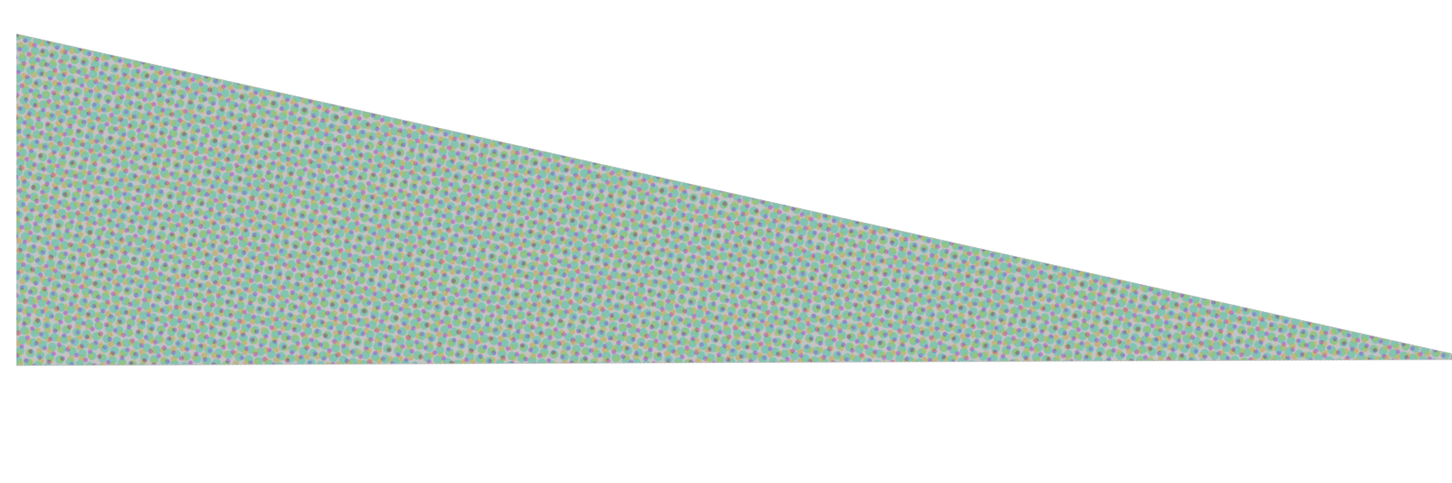
The SS Gairsoppa now rests five kilometres down at the bottom of the sea in a large impact crater.

Slide 5
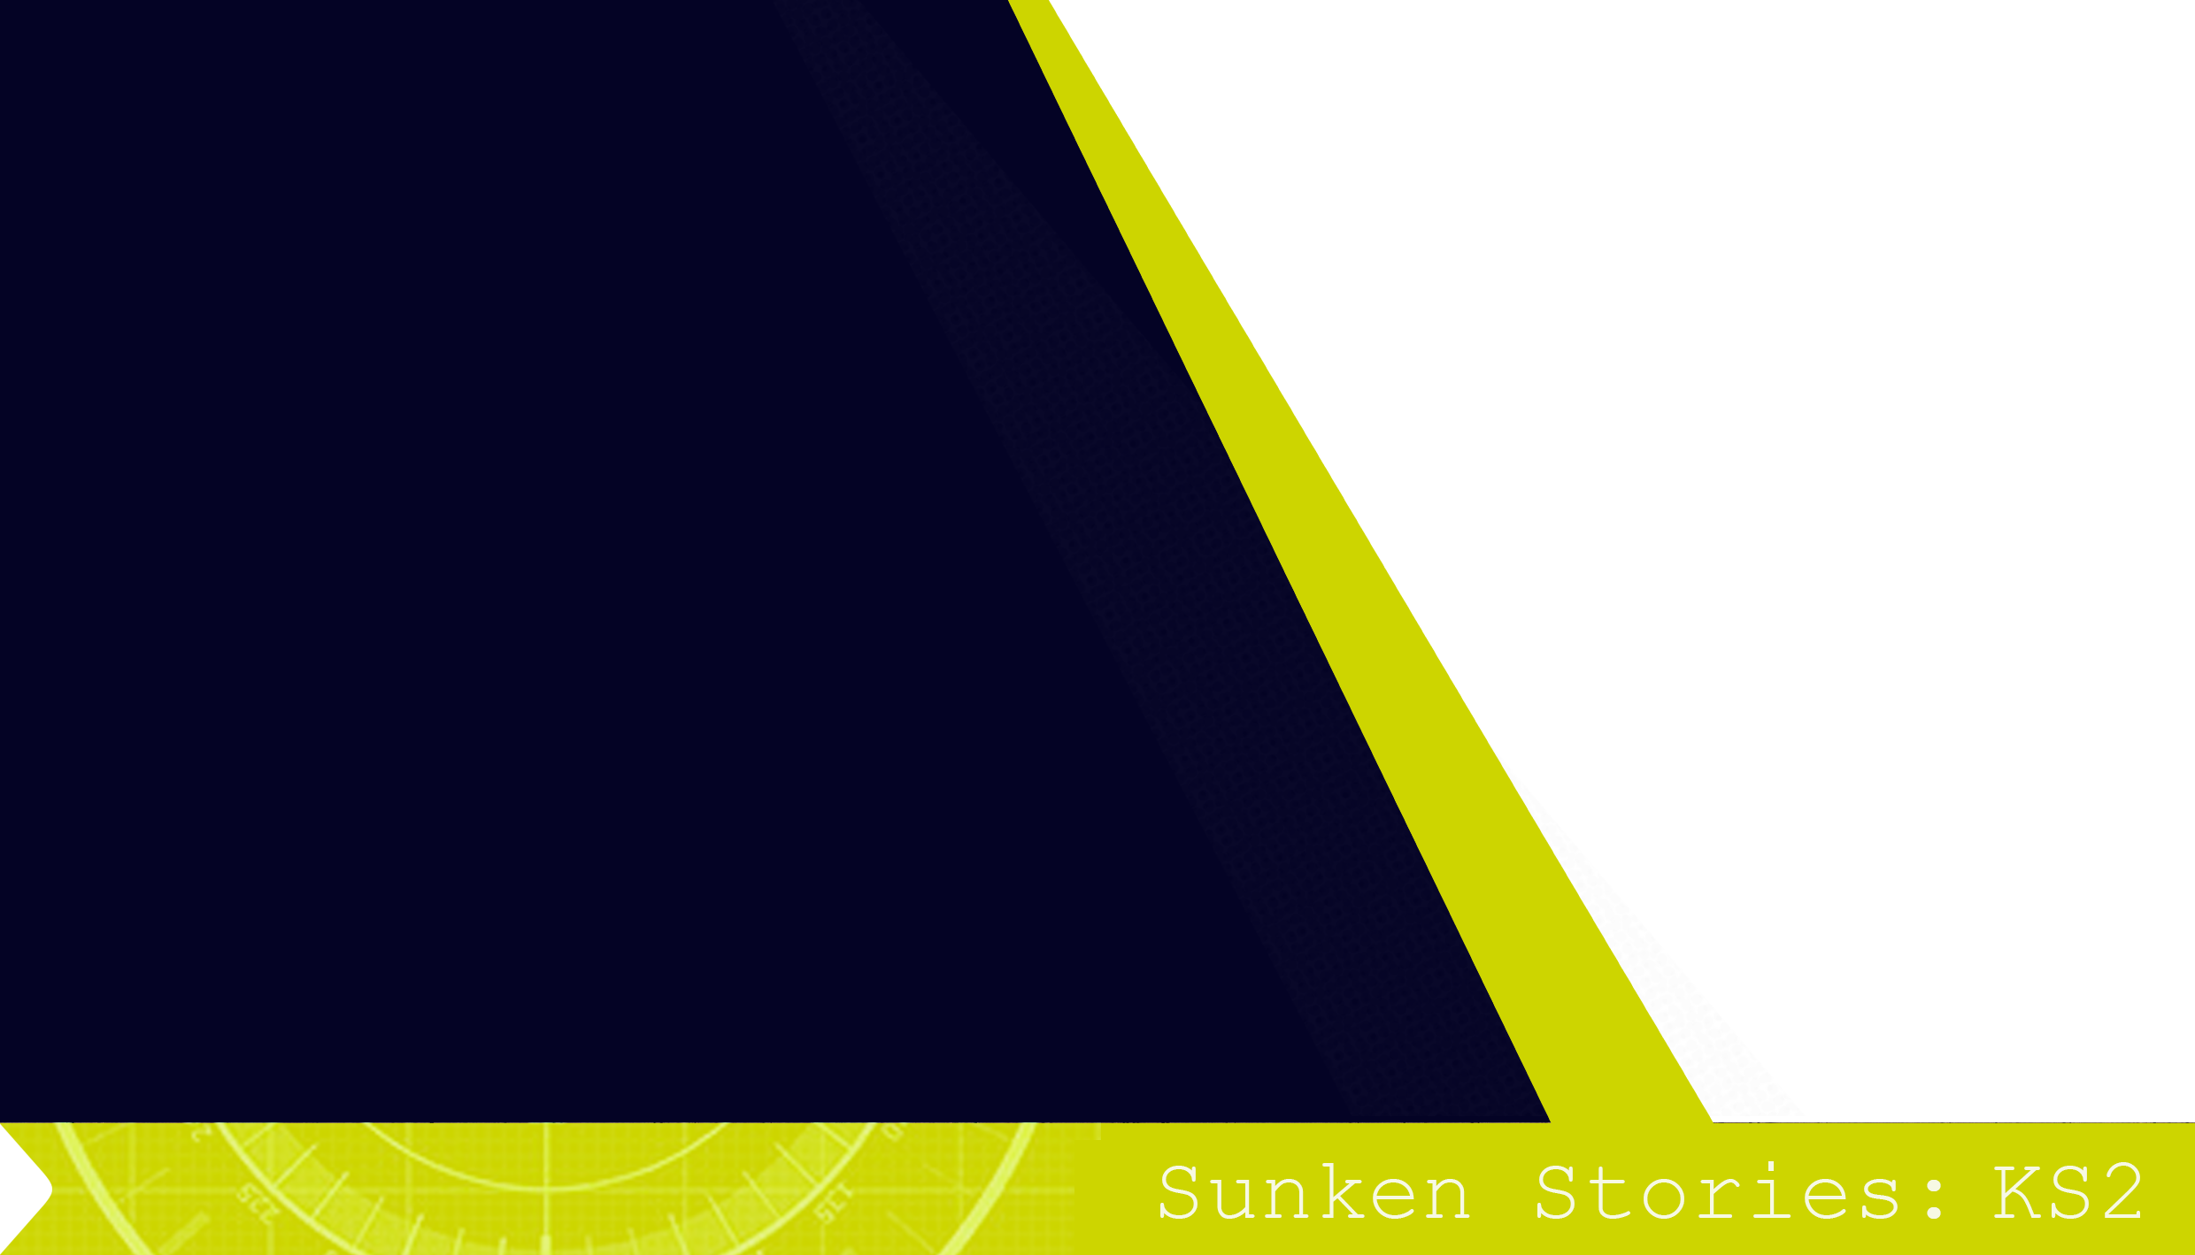
What could be the reason for such a large impact crater?
Maybe it’s because the wreck of the SS Gairsoppa is almost 5km underwater.
That’s the same as 35 London Eye’s stacked on top of each other!

Slide 6
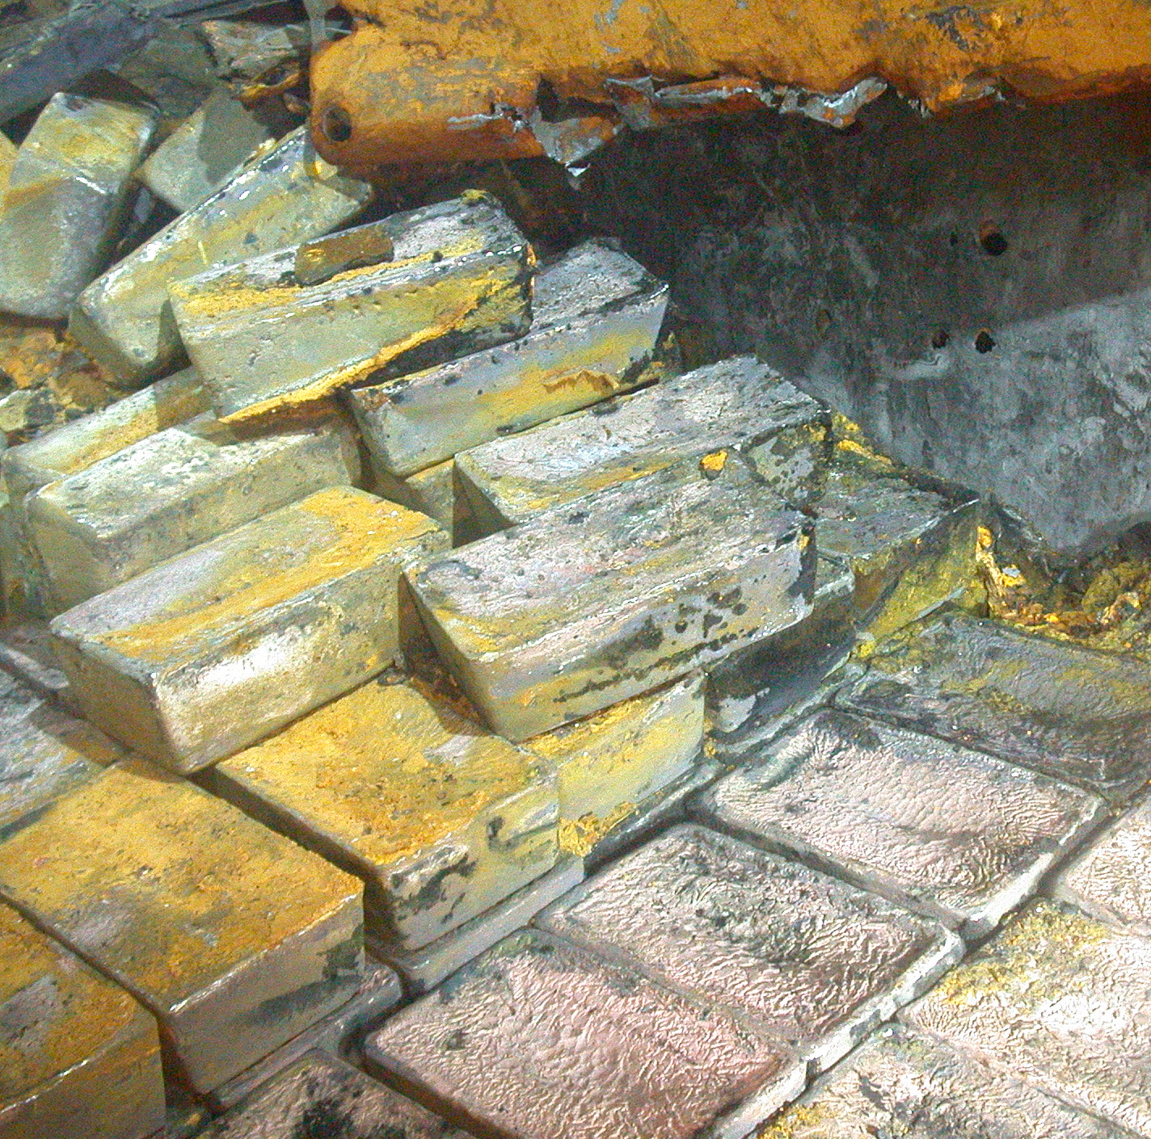
What other reasons are there for such a large impact crater?
The huge amount of silver and iron onboard made the ship very heavy.
There was also enough tea onboard to last the population of Britain for a whole week.

Slide 7
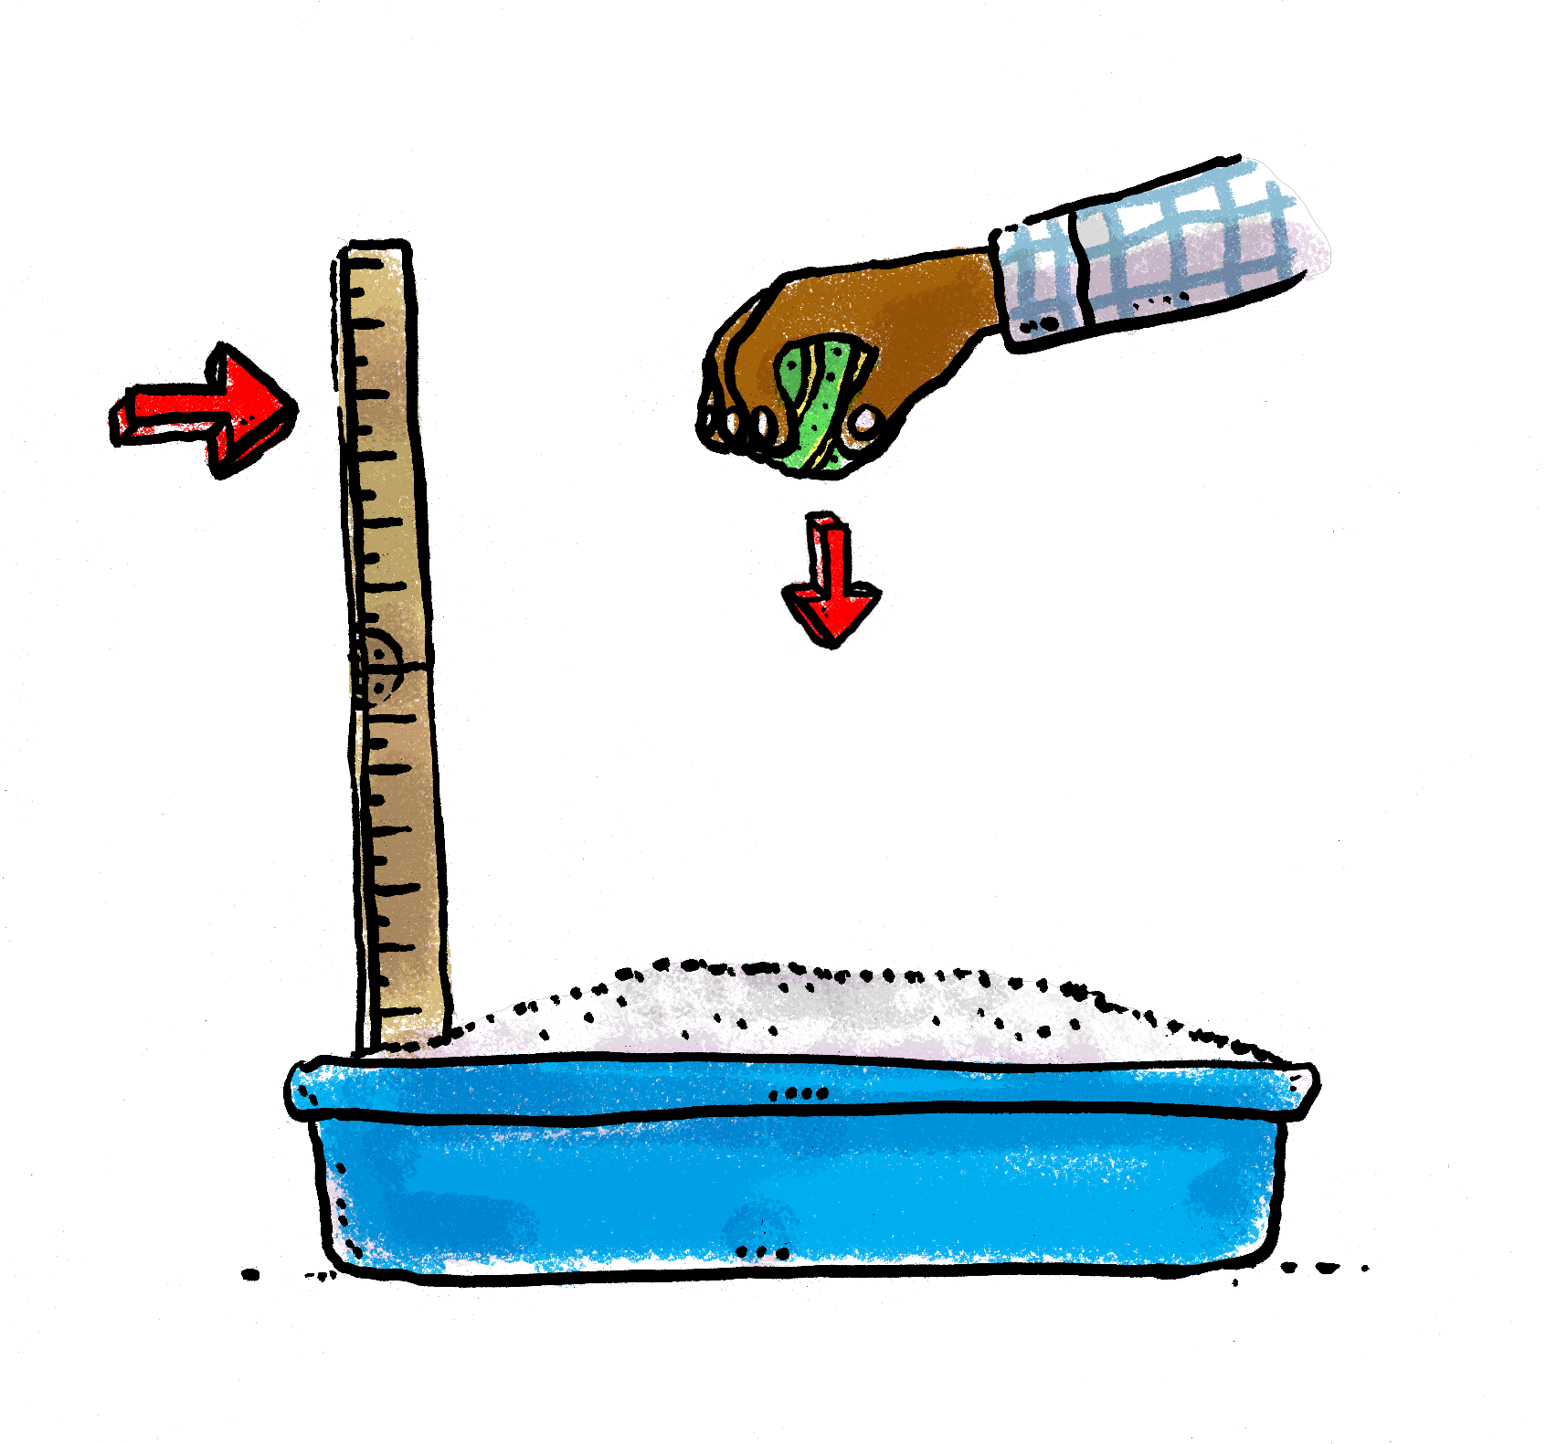
Let’s investigate these ideas with an experiment.
Will the weight or size of an object affect the depth of the impact crater?
What happens if the object falls from a greater distance?
Decide what apparatus to use.
Use the Activity Card to plan your experiment.

