Slide 1


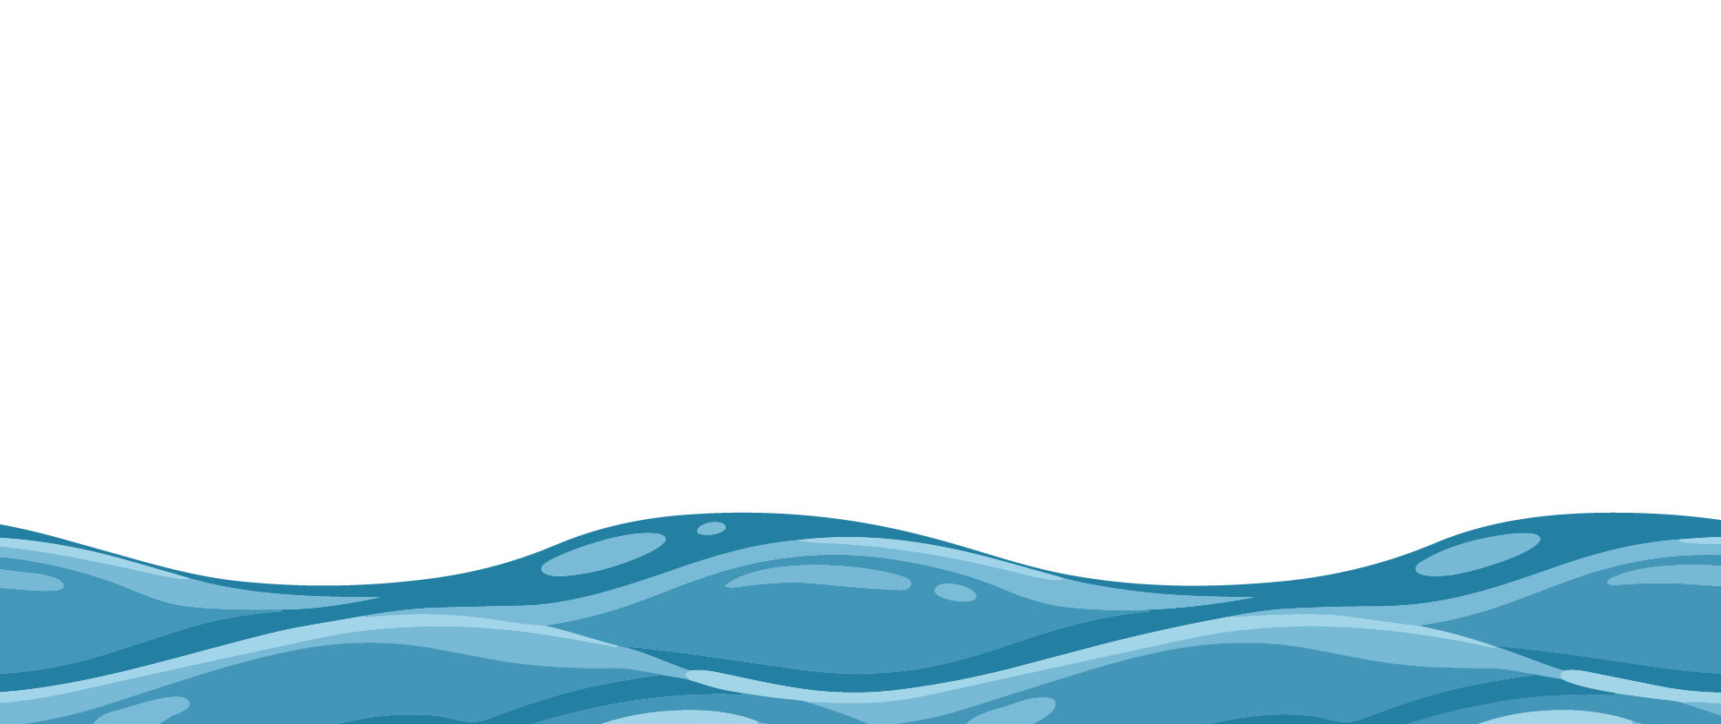
From Cloud to Tap:
The Journey of London’s Water
Clean Water for Life Resources © 2026
by Kempton Steam Museum are licensed under CC BY 4.0
KS2

Slide 2

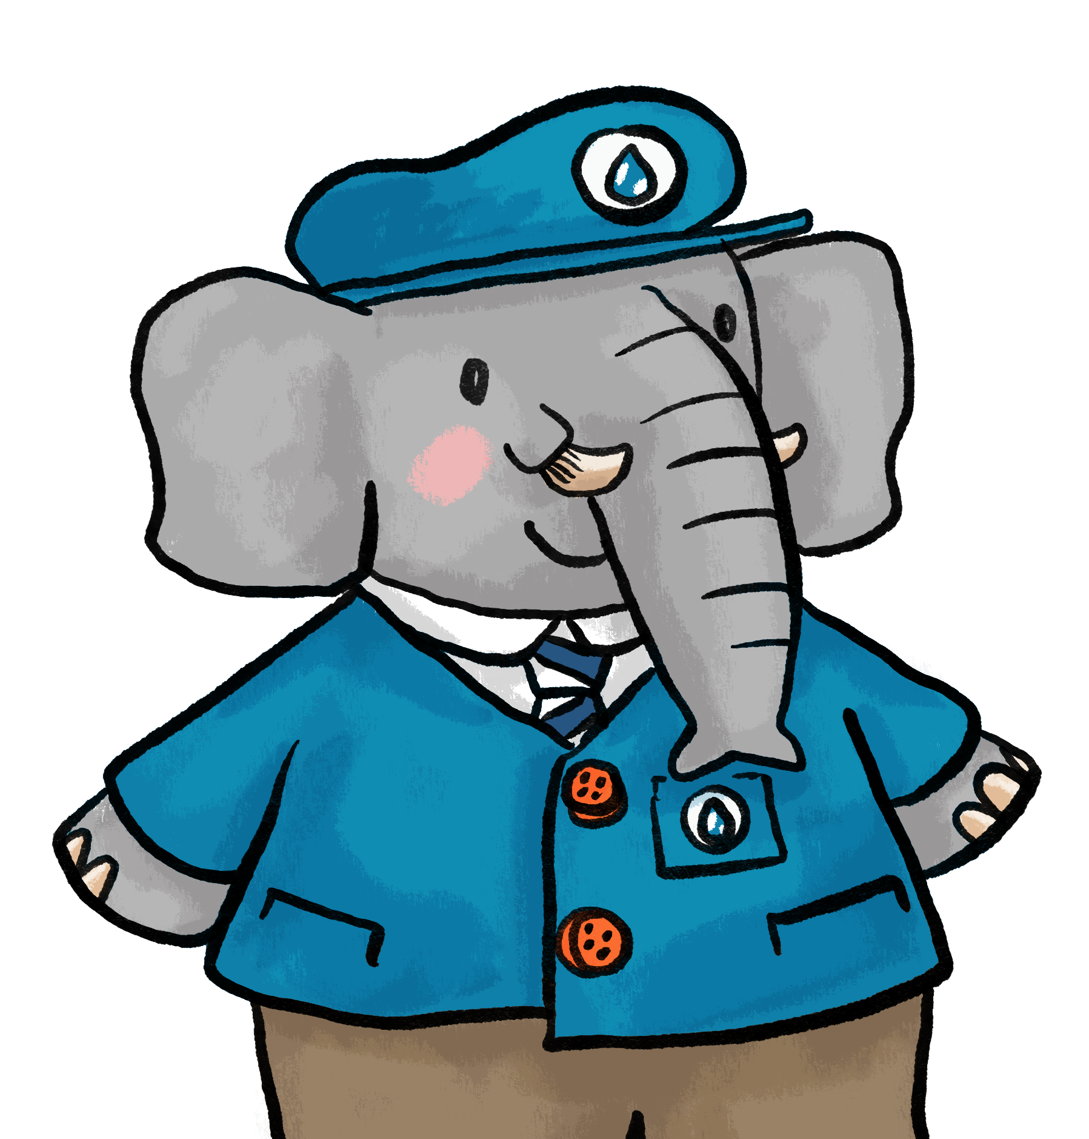
Have you ever thought about how clean water gets to your tap?
The water cycle
Condensation
Precipitation
Evaporation
It starts with the water cycle.
Collection
Water that falls as rain is collected in seas, lakes, rivers and streams.
Notes:
Discuss the terminology used in the water cycle: evaporation, condensation, precipitation and collection. Check understanding of each term.

Slide 3
London’s water starts as rain in the hills, all the way over in Kemble, in the Cotswolds.
River source
why can’t we use water straight from the river?
Water is taken from the River Thames near to Kempton.
It’s pumped to a reservoir until it’s ready to be cleaned.
Notes:
Ask ‘What do we mean by river source?’. Highlight that the source is in higher ground: water flows downhill – Link back to water cycle. Discuss what would happen if we drank water straight from a river. Even when water looks clean it can still contain bad bacteria and germs that could make us sick.

Slide 4
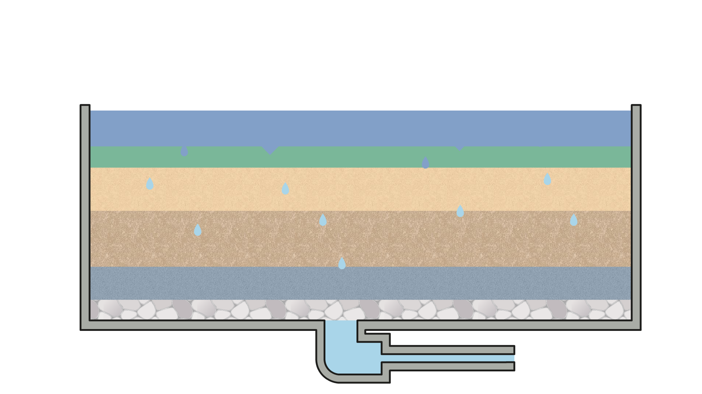
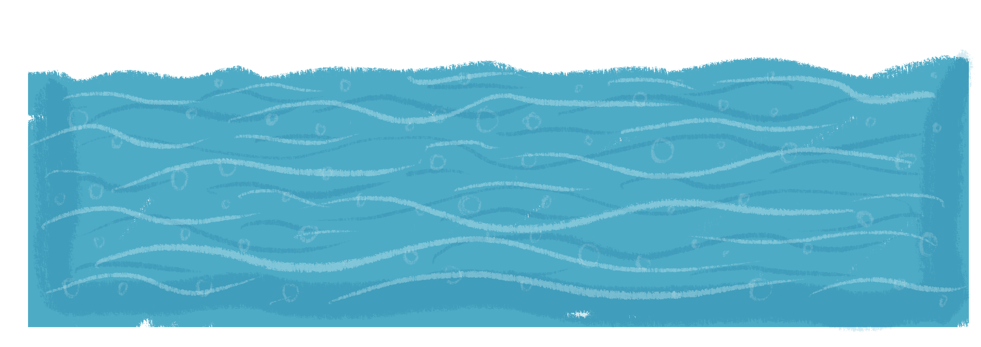
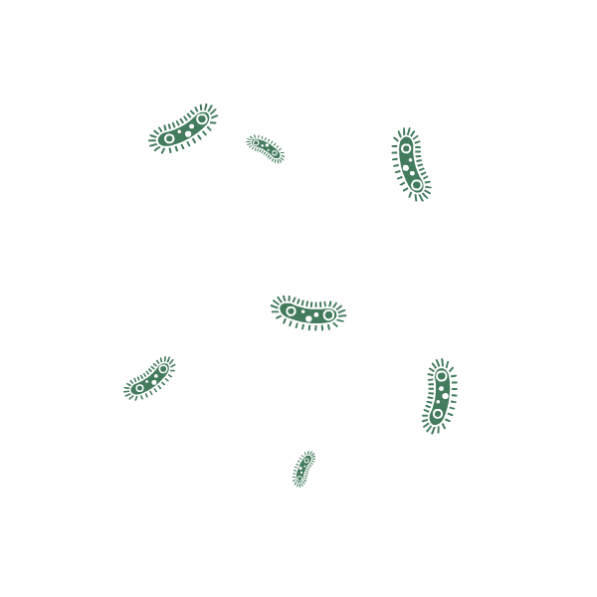
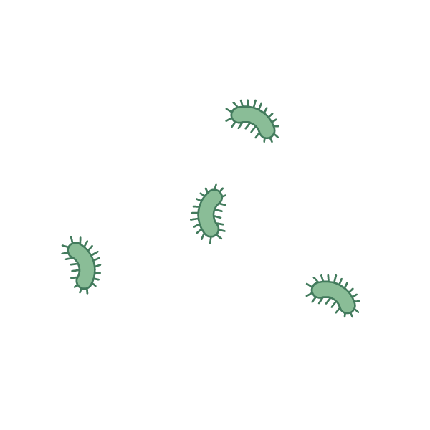
Cleaning the River Thames water
1
2
Filtration
3
Disinfection
Settlement
Firstly, the dirty water is pumped to a reservoir where the heavy clumps of dirt sink to the bottom.
Next, the clear water is passed through layers of good bacteria, sand and gravel to remove small particles.
Finally, the remaining bacteria is killed by adding chlorine or using UV light.
Notes:
Introduce systems thinking: parts working together. Emphasise that there are numerous steps in cleaning water; each step has a purpose and a process.
The current process is first settlement, where dirt and debris sink to the bottom of the storage reservoir. Then the water goes through a slow slow sand filtration process and is then finally treated with chlorine or UV light to kill remaining bacteria.

Slide 5
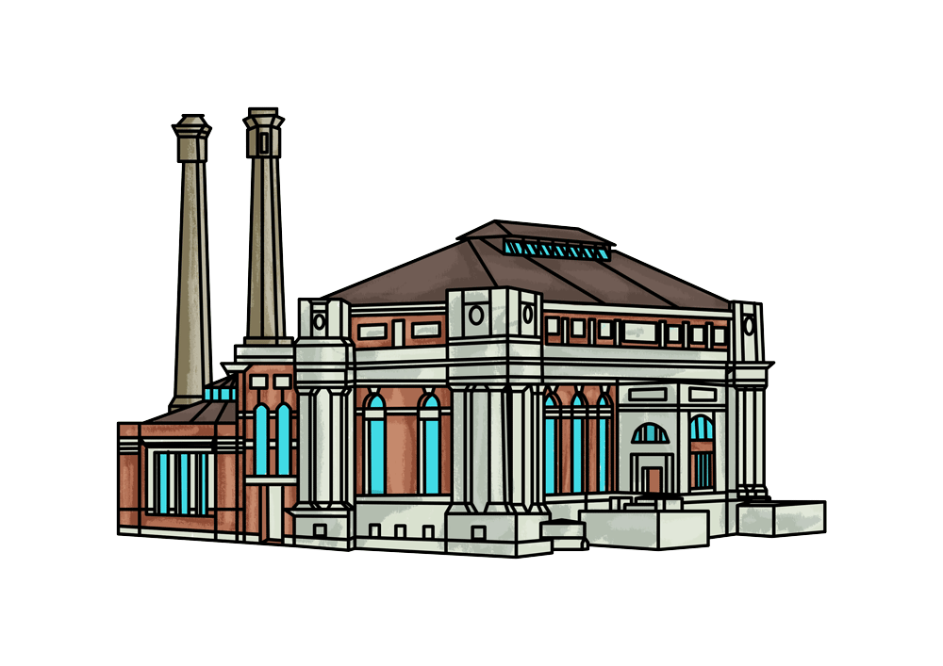
After being cleaned, the water is pumped to another reservoir.
Kempton Park Waterworks
The engines at Kempton Park Waterworks were built to pump the water.
Notes:
London’s water starts as rain in the hills. It flows into the River Thames, which begins near a place called Kemble. Highlight that the source is in higher ground. Reinforce idea: water flows downhill. Link back to water cycle.
were once used for pumping water to the reservoirs at Cricklewood such as the Bishops Wood Service Reservoir, but they have now been replaced with electric turbine technology.

Slide 6
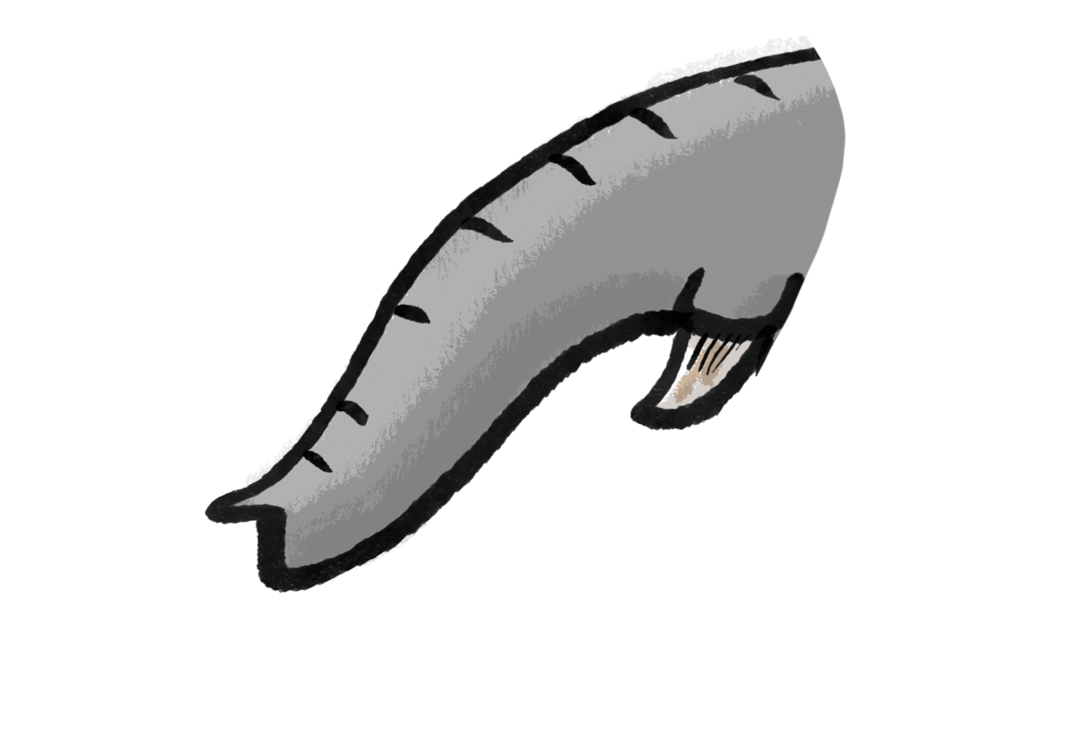
Water flows downhill
Raindrops fall from the sky.
Water naturally flows downhill because of gravity.
To get water up to a reservoir it needs help from a pump.
Rivers flow down to the sea.
Notes:
Explain, or even demonstrate that water flows downhill because of gravity - just like solid objects are pulled down to earth, so are liquids.

Slide 7
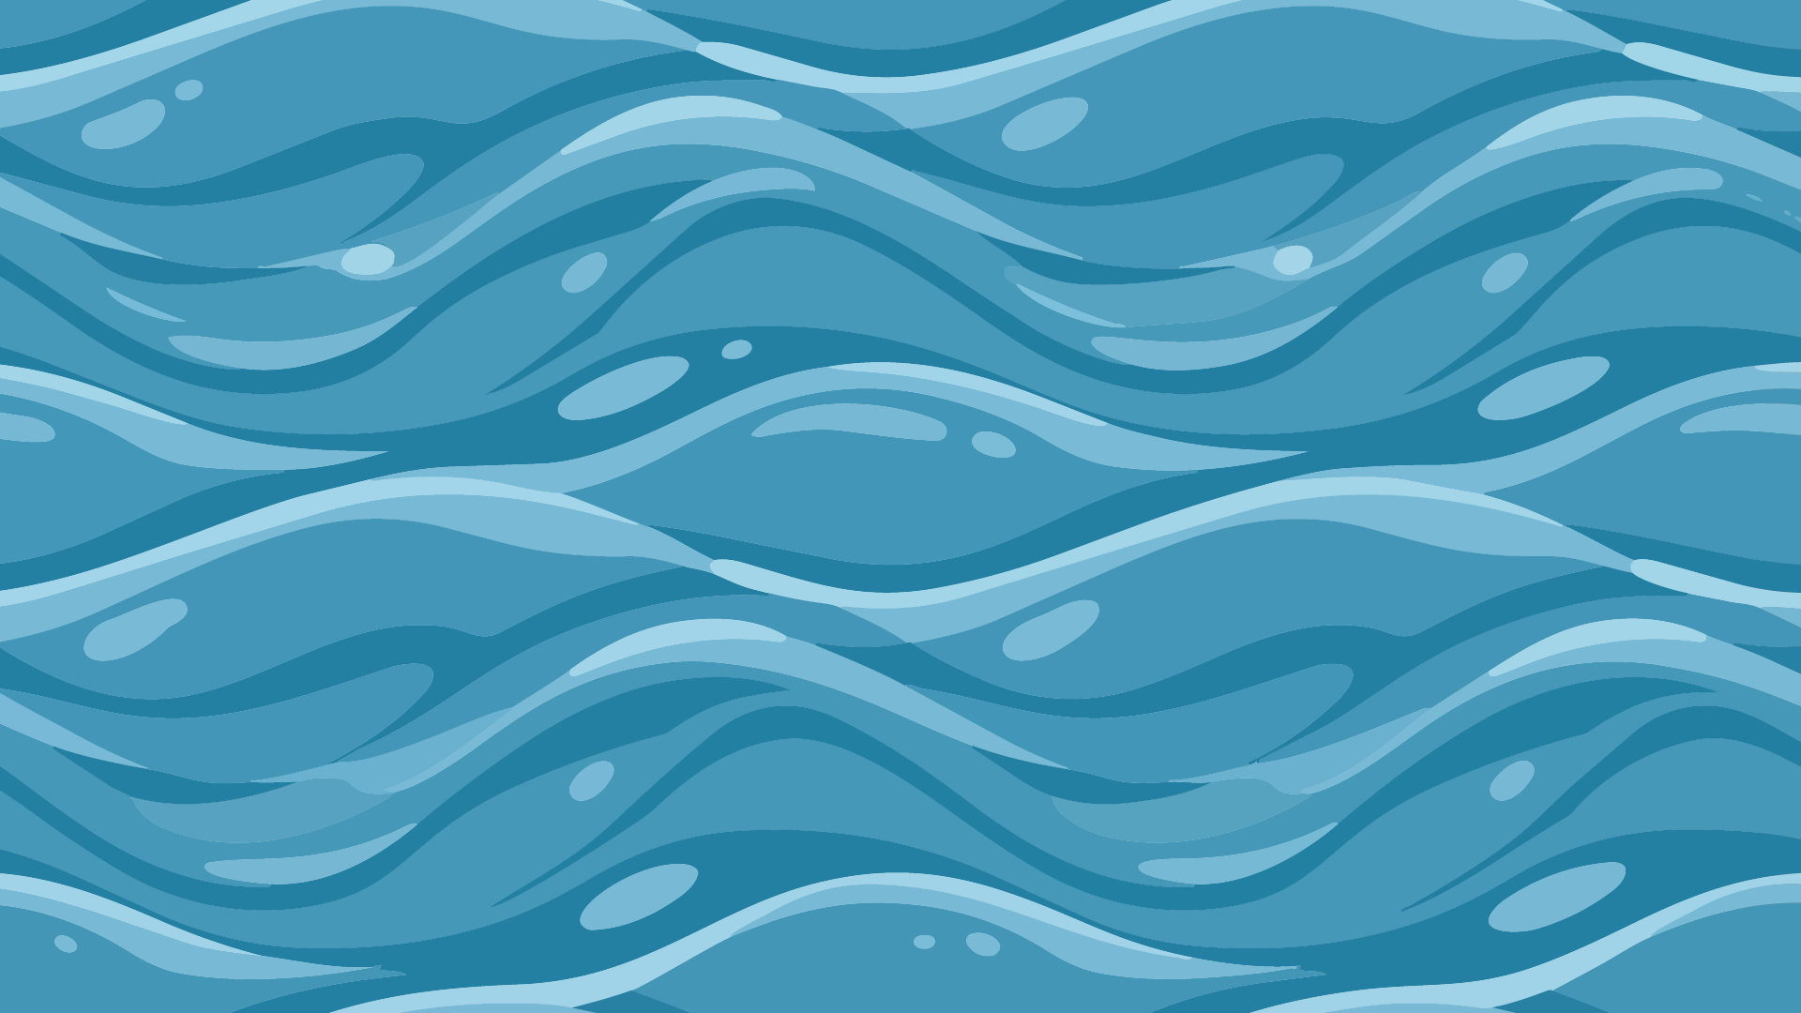
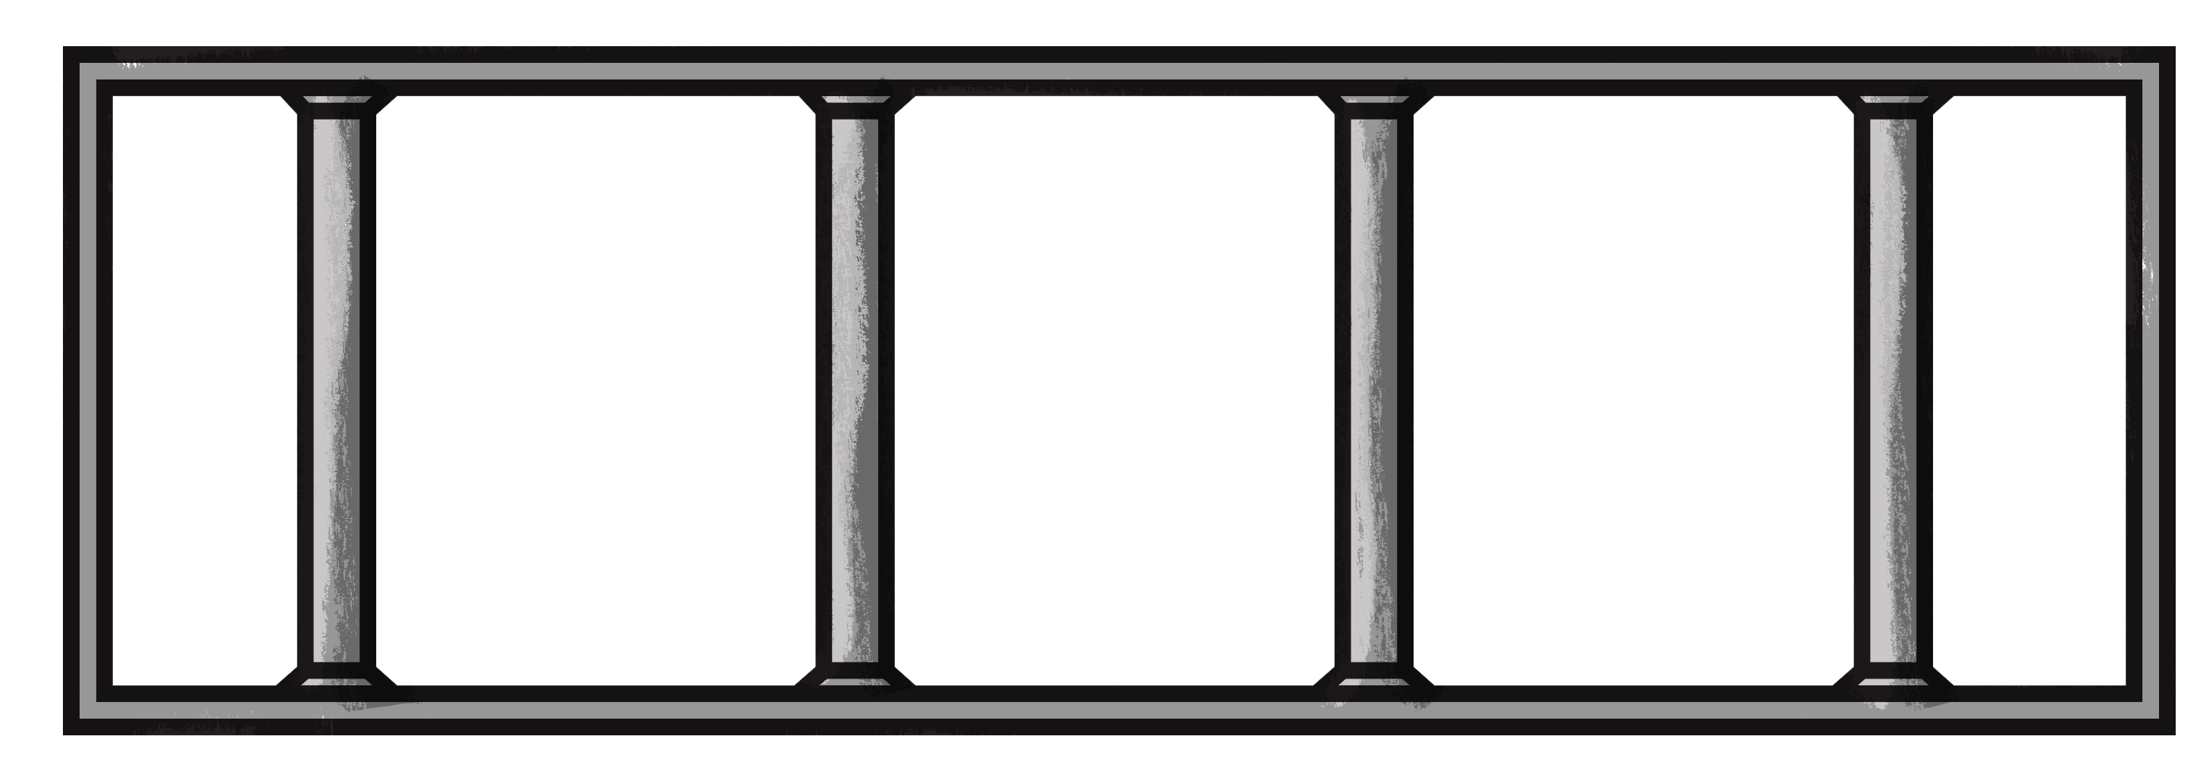
Reservoirs
A reservoir is where water is stored.
They are man-made structures and can be open, like a lake or they can be covered to protect the water from getting dirty.
Reservoirs are often built on higher ground so that gravity can help move water to next stage of the journey.
Water level goes up and down.
Why do we need to store water?
Notes:
Explain that a reservoir is a large man-made place, a bit like a lake, where water is stored. They can be open, like a lake, or they can be covered/underground to protect the water from getting dirty. Explain that reservoirs are often built on higher ground so that gravity can help move water to next stage of the journey.
In dry weather or when people are using a lot of water, the water level drops. In wet weather or when people are not turning on taps as much the water level rises.
Water is stored in reservoirs because we don’t get rain every day but people always need water and we need different amounts of water at different times. More people are living in cities. Ask: “What would happen if we didn’t store water?”. Think about short-term challenges like hot days and long-term challenges like climate change.

Slide 8
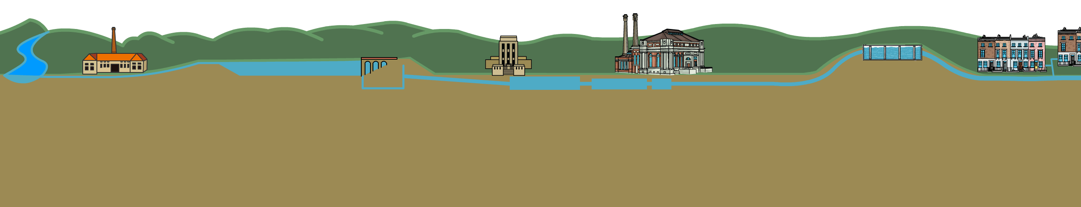
Water’s journey to London taps
Bishops
Wood
Covered
Service
Reservoir
Littleton Pumping Station
Queen Mary Storage
Reservoir
Kempton Park Waterworks
River
Thames
Filtration
Water
treatment
London
1
4
2
5
3
Dirt and sediment sink to the bottom
of the reservoir.
The water stays here until it’s needed.
With the help of gravity, water is moved to the cleaning stage.
Particles of dirt are trapped in filters.
6
7
The clean water is stored in a covered service reservoir until needed.
8
With the help of gravity, the clean water is released to homes and businesses.
Water is taken from the River Thames.
Water is pumped up to the storage reservoir using engine power.
The water is treated to kill germs and bacteria.
The clean water is sent up to the service reservoir using a pump.
Notes:
1. Water is taken from the River Thames.
2. Water is pumped up to the storage reservoir using engine power.
3. Dirt and sediment sink to the bottom of the reservoir. The water stays here until it’s needed.
4. With the help of gravity, water is moved to the cleaning stage. particles of dirt are trapped in filters.
5. The water is treated to kill germs and bacteria.
6. The clean water is pumped up to the service reservoir using engine power.
7. The clean water is stored in a covered service reservoir until needed.
8. With the help of gravity, the clean water is released to homes and businesses.

Slide 9
Water in demand
Least Water
Flushing the toilet
Having a bath
Some activities use more water than others.
Are these in the correct order?
5 litres
Having a shower (4 mins)
Using a dishwasher
15 litres
Using the washing machine
Having a shower (4 mins)
40 litres
Flushing the toilet
Using the washing machine
50 litres
Using a dishwasher
Having a bath
100 litres
Most Water
Notes:
Discuss with the class that some activities use more water than others. Discuss which of the activities might use the most least water. Explain that is takes a lot of effort and energy to get the water to your taps so we need to use it sensibly and with respect.

Slide 10
How much water?
How many litres of water do you think you use in a whole week?
Water use activity | Monday | Tuesday | Wednesday | Thursday | Friday | Saturday | Sunday | Total number in a week | Estimated water used (litres) | Total weekly water used
Flushing the toilet |  |  |  |  |  |  |  |  | 5
Brushing your teeth |  |  |  |  |  |  |  |  | 2
Washing face or hands |  |  |  |  |  |  |  |  | 4
Shower |  |  |  |  |  |  |  |  | 40
Bath |  |  |  |  |  |  |  |  | 100
Drink |  |  |  |  |  |  |  |  | 0.25
Washing the dishes by hand |  |  |  |  |  |  |  |  | 10
Using a dishwasher |  |  |  |  |  |  |  |  | 25
Cooking and food preparation |  |  |  |  |  |  |  |  | 10
Other activities
Notes:
Can children make rough estimate of their water use for one week? Demonstrate what a litre looks like.

Slide 11
Water use prediction
Water use activity | Monday | Tuesday | Wednesday | Thursday | Friday | Saturday | Sunday | Total number in a week | Estimated water used (litres) | Total weekly water used
Flushing the toilet |  |  |  |  |  |  |  |  | 5
Brushing your teeth |  |  |  |  |  |  |  |  | 2
Washing face or hands |  |  |  |  |  |  |  |  | 4
Shower |  |  |  |  |  |  |  |  | 40
Bath |  |  |  |  |  |  |  |  | 100
Drink |  |  |  |  |  |  |  |  | 0.25
Washing the dishes by hand |  |  |  |  |  |  |  |  | 10
Using a dishwasher |  |  |  |  |  |  |  |  | 25
Cooking and food preparation |  |  |  |  |  |  |  |  | 10
Other activities
Notes:
Use the table (printable pdf version available on the website) to estimate water usage over a week. This could be a whole class activity or an individual task.

Slide 12
Plan your own water system
This city needs a reliable water supply.
Your task is to help plan a new water system.
Choose a location for:
1st pumping station
(to pump river water to
storage reservoir)
A storage reservoir
(to store extracted water)
A filter house
(to clean the water)
2nd pumping station
(to pump clean water to the
service reservoir)
Covered service reservoir
(to store clean water)
Notes:
Use the printable sheet with your children to plan locations for the 5 parts of their new water system. Talk about the contours on the map showing areas of higher ground. Remind children that reservoirs should be located on higher ground so that gravity can help with water delivery to taps.
Think about:
Where should fresh water be stored?
Where should clean water be stored?
How will water reach the town?
How will you power your pump?

Slide 13
4 Figure Grid Referencing
Notes:
4 figure grid referencing: Practice using 4-figure grid references by labelling the map.
1st pumping station
(to pump river water to
storage reservoir)
A storage reservoir
(to store extracted water)
A filter house
(to clean the water)
2nd pumping station
(to pump clean water to the
service reservoir)
Covered service reservoir
(to store clean water)

Slide 14
6 Figure Grid Referencing
Notes:
For upper Key Stage 2: 6-figure grid referencing: Practice using 6-figure grid references by labelling the map.
1st pumping station
(to pump river water to
storage reservoir)
A storage reservoir
(to store extracted water)
A filter house
(to clean the water)
2nd pumping station
(to pump clean water to the
service reservoir)
Covered service reservoir
(to store clean water)

Slide 15

Design a coat of arms
This is the Metropolitan Water Board coat of arms – the symbol of the organisation formed in 1903 to manage the water supply of the city of London.
It includes the motto “and I caused it to rain upon one city”.”
Design a coat of arms for your new water system.
What symbols would you use?
What would be your motto?
Notes:
The huge mosaic crest can be seen on the wall of the Kempton Steam Museum.
Use the printable sheet to think about symbolism and link to Greek mythology. Children could colour in the Metropolitan Water Board Coat of Arms then have a go at creating their own design.
A hand from a cloud, scattering drops of water. The eight droplets represent the eight water companies that joined to form the larger Metropolitan Water Board (MWB).
The shield contains a St. George’s Cross (the cross of London) with a golden Lion of England, tying the board to the capital city.
The shield is flanked by mythological figures related to water and health. The right side depicts Hygeia (the Greek goddess of health), while the left side represents Aquarius (the water bearer).

