Slide 1


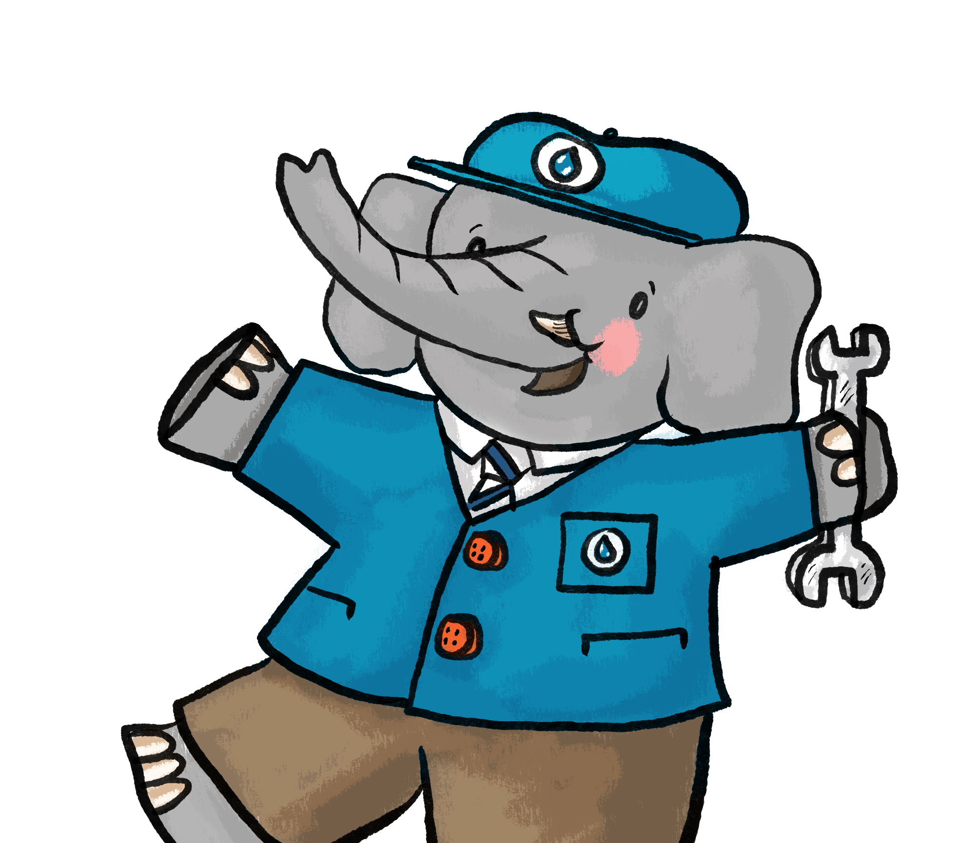

Puff, Push, Power!
Clean Water for Life Resources © 2026
by Kempton Steam Museum are licensed under CC BY 4.0
KS1

Slide 2

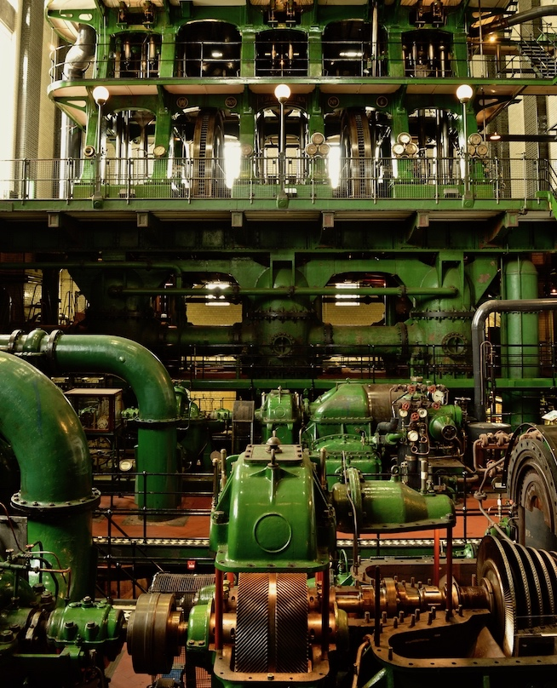
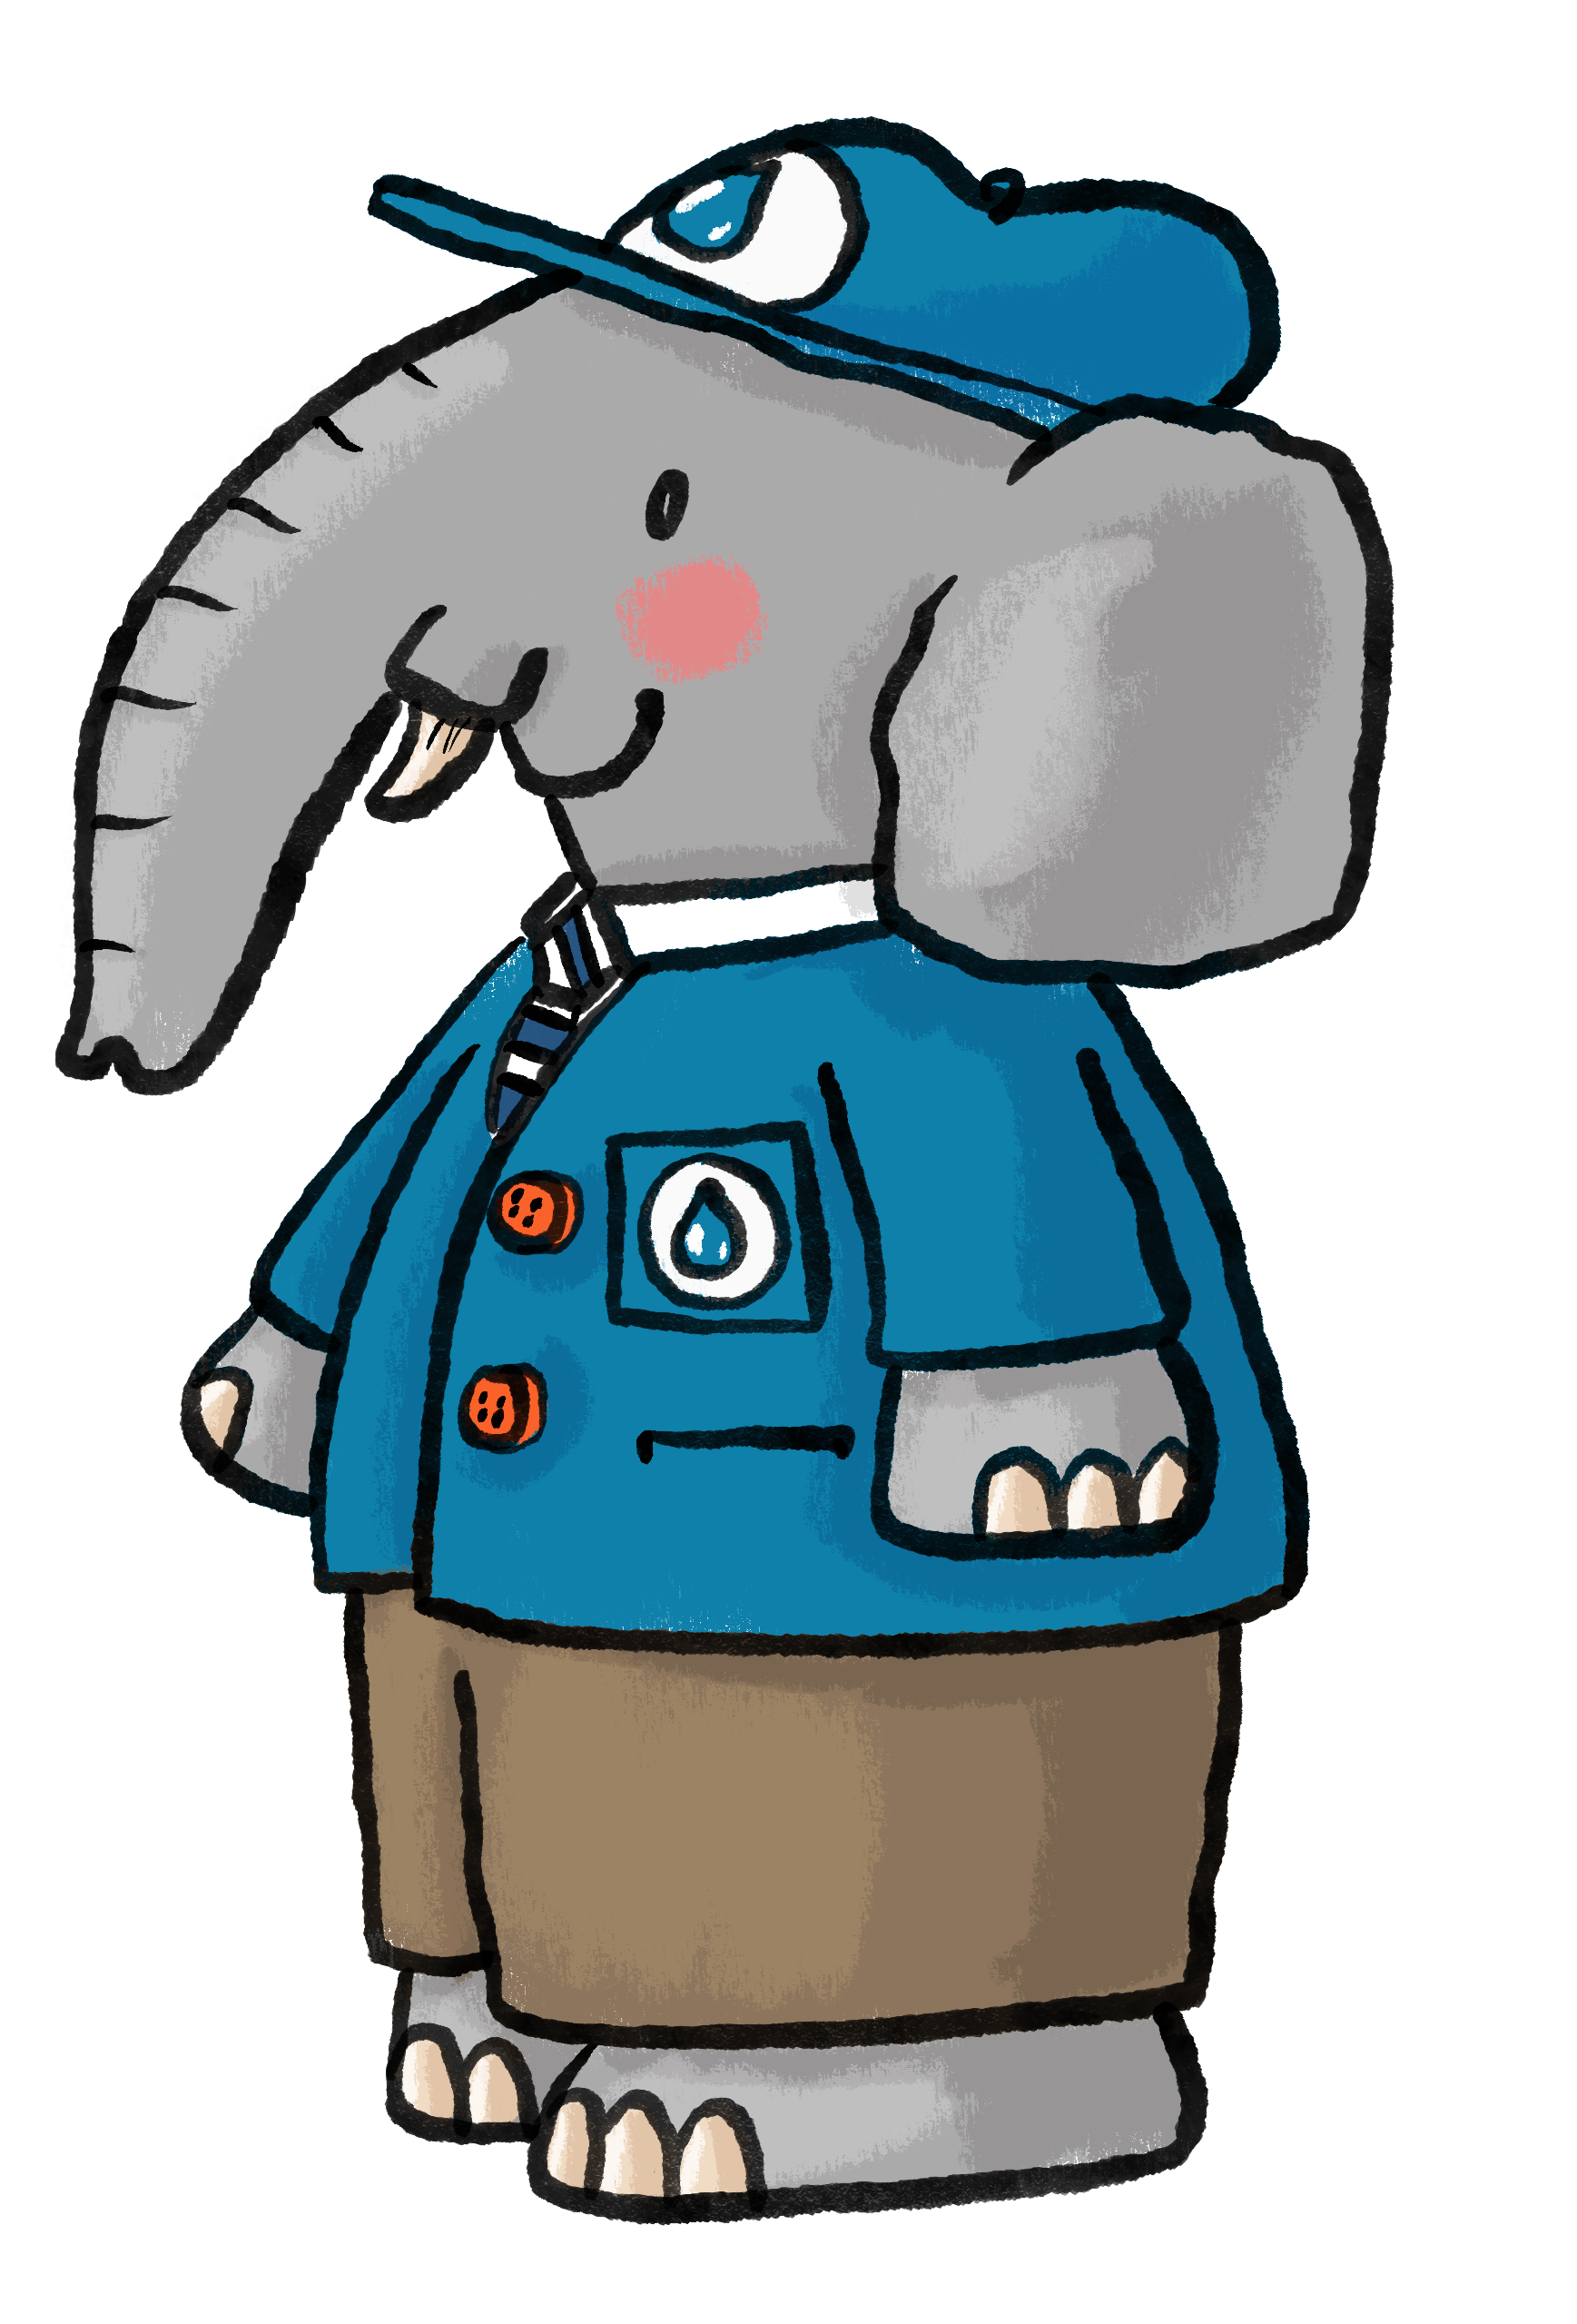
Engines
Engines are amazing machines that make things move!
Notes:
Discuss what children think we might use engines for.
Ideas: Travel (cars, planes trains), power tools, lawnmowers, rockets, tractors.

Slide 3
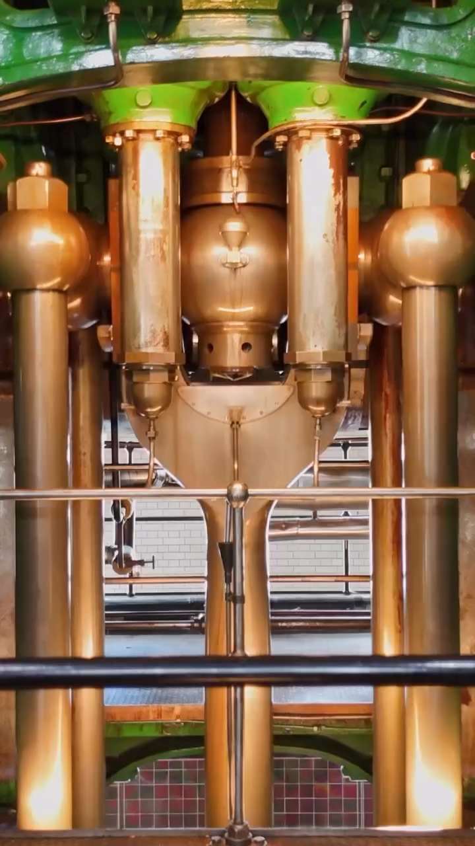
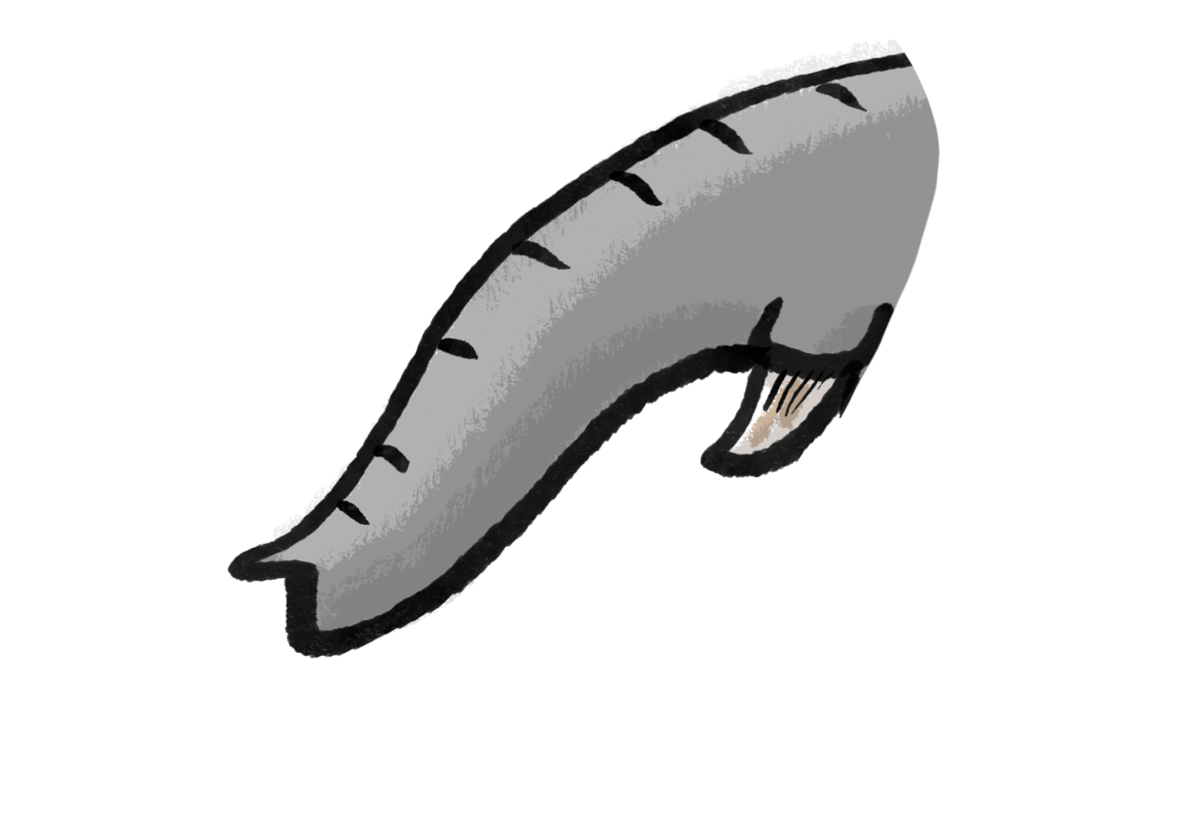
Push, pull, spin
Engines use energy to push, pull, or spin parts to create movement.
What helps to make you move?
Notes:
Explain that engines make a push, a pull or a spin. If there is room ask children to do a ‘push’ action, a ‘pull’ action and a spin action. Then ask what is helping us to move - talk about muscles, bones, bodies, food/energy. Encourage children to think about their own bodies as an engine.

Slide 4
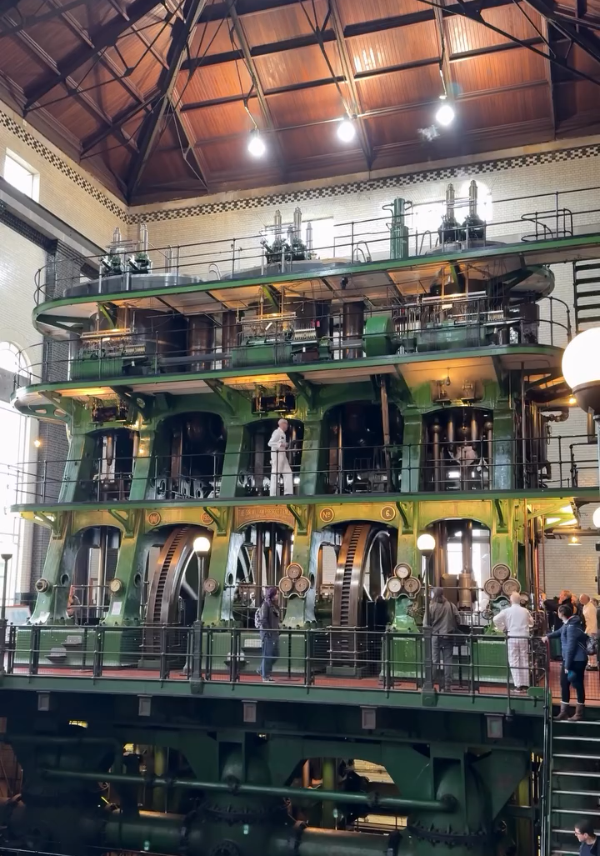
The Sir William Prescott Engine is the world’s largest working triple-expansion steam engine.
It’s 19 metres tall.
How many stacked up
double-decker buses is that?
1
2
3
4
Notes:
The Sir William Prescott Engine at Kempton Steam Museum is enormous - 19 metres tall. Taller than 4 double-decker buses.

Slide 5



What was the engine
used for?
Here’s a clue…
Trunk up
for Yes
Trunk down for No
Can water flow uphill?
Notes:
Engines are usually needed to do a job. After showing children pictures and videos of the William Prescott Engine what job do they think it might do? There are no right or wrong answers.
Ask: Can water flow uphill – Active voting with trunks up for yes down for no.

Slide 6
Water flows downhill
Raindrops fall from the sky
Water naturally flows downhill because of gravity.
To get water uphill it needs to be pumped by an engine.
Rivers flow down to the sea
Notes:
Explain, or even demonstrate that water flows downhill because of gravity - just like solid objects are pulled down to earth, so are liquids. It can’t go uphill on its own.

Slide 7
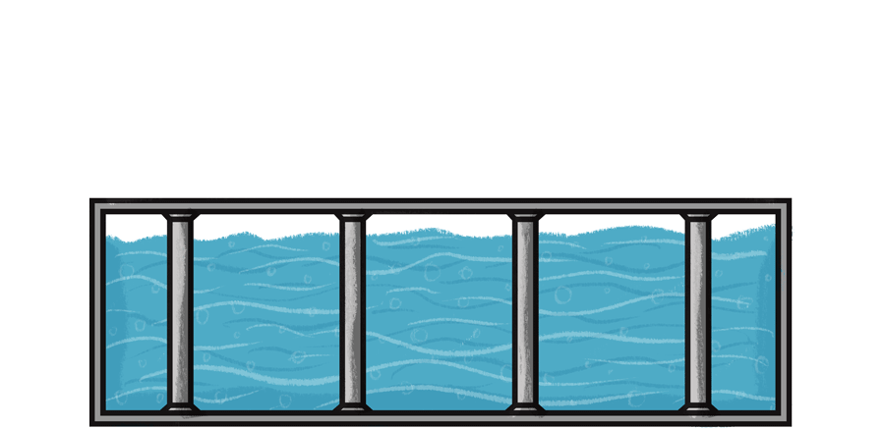
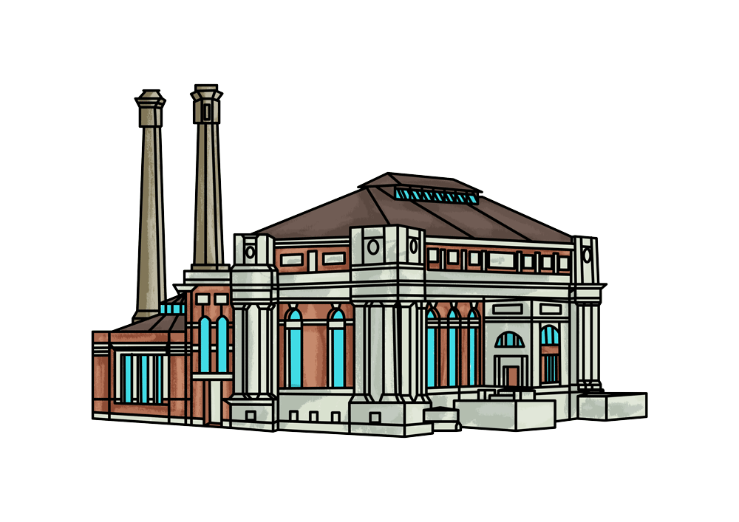
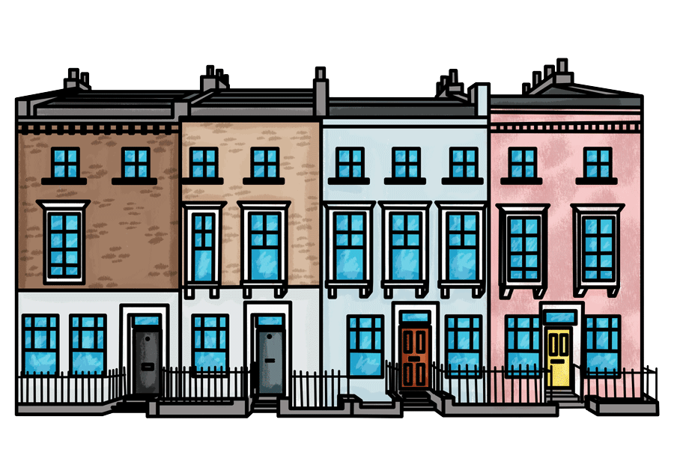
Pump power!
The engines at Kempton Park Waterworks were used to pump clean water uphill to a reservoir, ready for the people in London to turn on their taps.
Reservoir
(to store water)
Kempton Park Waterworks
(Kempton Steam Museum)
London
Notes:
Describe how the steam engines were once used for pumping water to a reservoir. Explain that a reservoir is a huge storage place for water - sometimes reservoirs are like lakes, other times they are massive underground tanks.

Slide 8
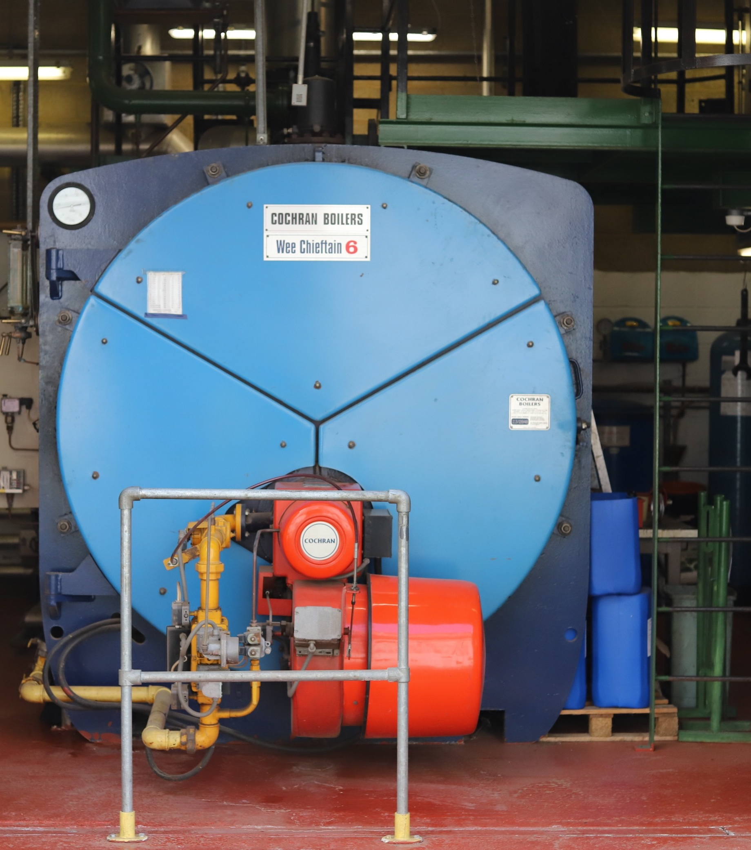
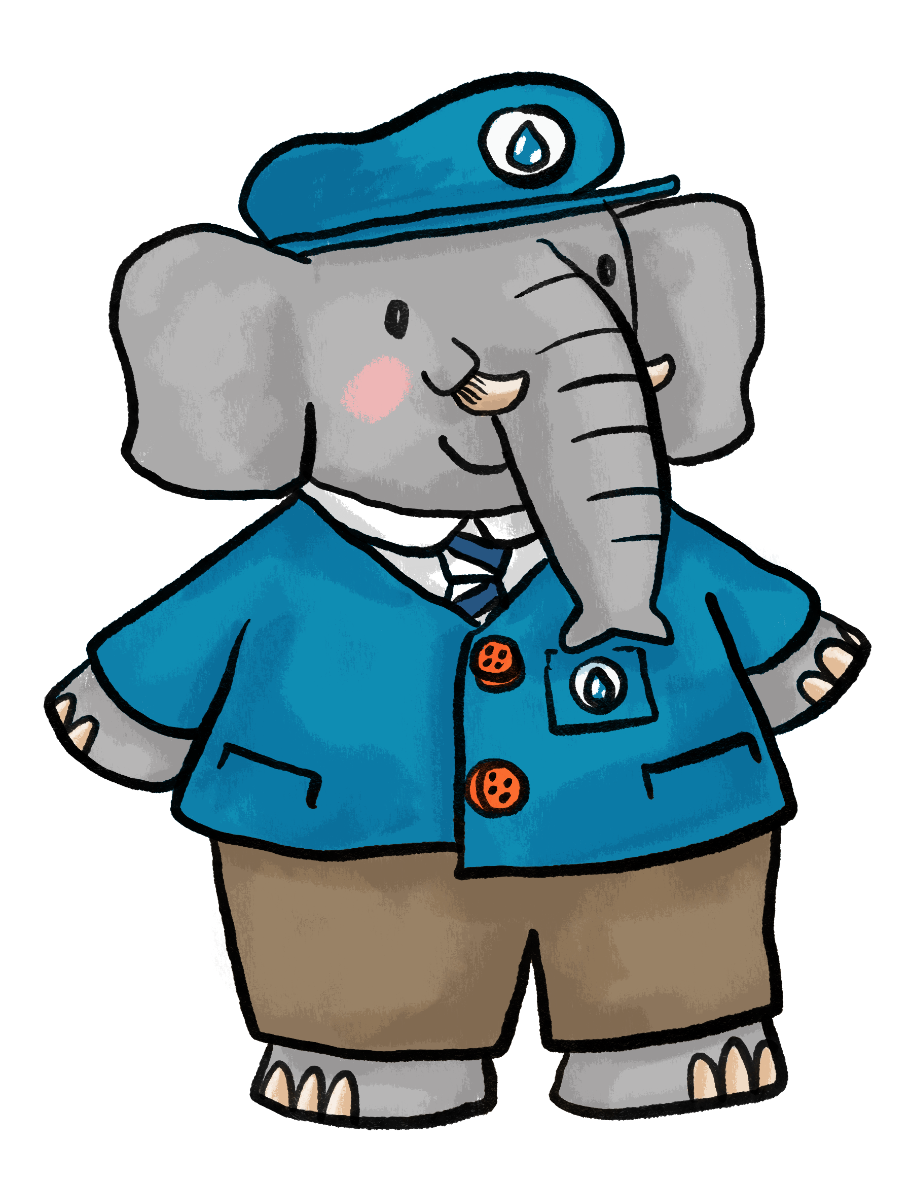
It starts with steam
The gas boiler
We use a
gas-fired boiler to make steam.
Water is heated in a boiler until it turns to steam – whoosh!
The steam travels to the engine to make the piston move.
Notes:
Ask – ‘What do steam engines need to make them work?’ Historically the steam was made in coal fired boilers, today they are powered by gas. This is more controllable and efficient than coal.

Slide 9
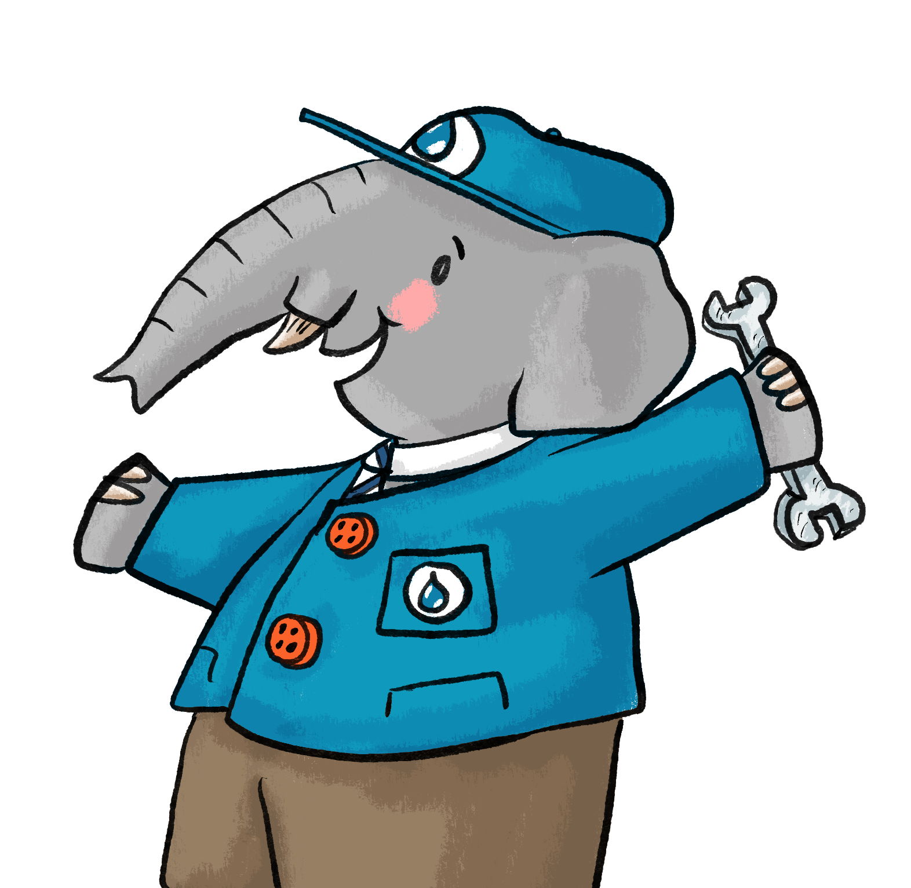
Here’s how the steam engine worked.
Let’s take one step at a time and do some fun actions along
the way…
Warm up your trunks!
Notes:
Prepare the children to do some physical actions to the different part of an engine.

Slide 10





Step one and two
Gas fuel is burnt in the boiler to heat a tank of water.
The water in the tank turns to steam. Steam has lots of power and energy.
1
2
Action: Wave your arms (or trunk) in the air like flames.
Action: Drum your hands quickly on your knees like powerful, energetic steam.
Notes:
Step 1: Get children to wave their arms in the air to represent flames heating the water.
Step 2: Get children to drum their hands quickly on their knees like powerful, energetic steam, representing particles bouncing around. Fun fact - it takes us 3 days to fire up the engine, check pressures etc.

Slide 11
Step three and four
When the steam is ready, the engineers open up the valve.
Steam takes up more and more room. It pushes its way through pipes, to the engine.
3
4
Action: Turn the valve to release the steam.
Action: Snake your arms left and right, like steam travelling in a pipe.
Notes:
Step 3: Get children to do a turning action with their hands, pretending to open a stiff valve to release the steam. Talk about how a valve acts like a door, you can open or close it, to keep steam in or let it out.
Step 4: Get children to put their hands together and snake them around like steam travelling through the pipes.

Slide 12
Step five and six
A valve directs the steam to one end of the cylinder then the other and the piston moves up and down.
At the engine, the powerful steam pushes the piston inside a cylinder.
5
6
Piston
Action: Push your arms down by your sides like the powerful steam.
Action: Pump your arms up and down like the piston inside the cylinder.
Notes:
Step 5: Get children to stand up and push their arms down by their sides in slow powerful action like the first move of the piston.
Step 6: Now children can pump their arms up and down quite quickly like the powerful reciprocating motion (straight line motion, back and forth or up and down) of the piston.

Slide 13
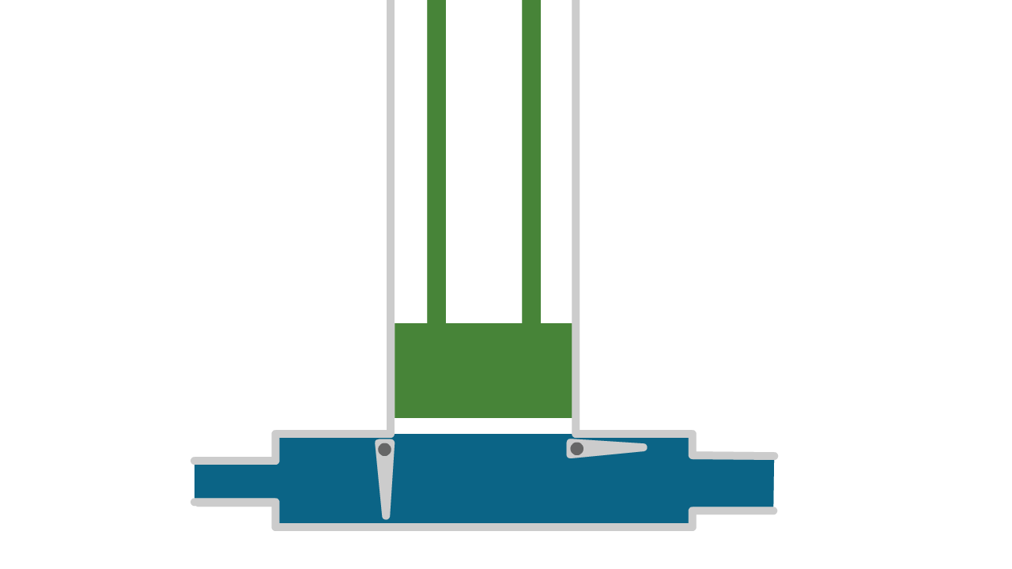
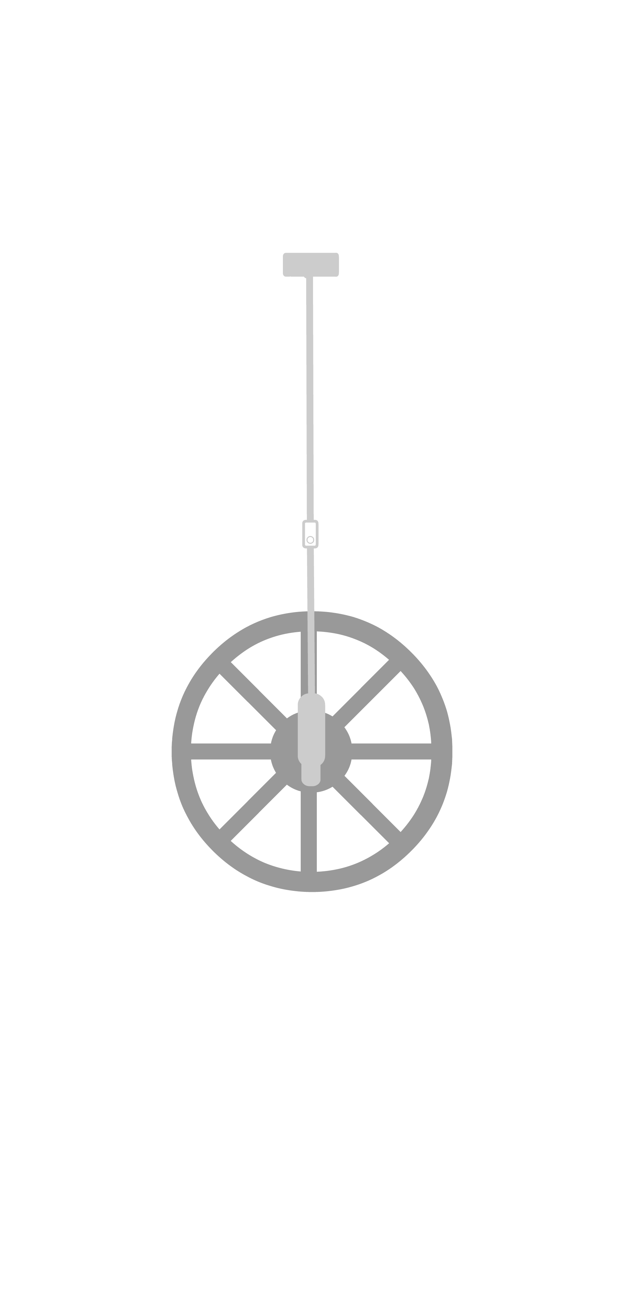
Step seven and eight
The piston powers a plunger. This sucks up the clean drinking water, then pushes it out towards the reservoir.
The piston is attached to a crank and a flywheel. This turns straight motion into ‘round and round’ motion and makes the engine run smoothly.
7
8
Action: Use your lungs to suck in air and blow it out in a big breath.
Make a sucking and whooshing noise if you like!
Action: Stand on one leg. Pedal your other leg, like you’re riding a bike.
See how your knee goes up and down, but your ankle goes round and round.
Notes:
Step 7: Get children to use their lungs and breath to suck in air and blow it out in a big breath. Liken the pump to a medicine syringe. You could demonstrate this with a syringe and a bowl of water.
Step 8: The crank is a way to turn straight-line motion into round and round motion (reciprocal to rotary). If possible, get children to stand on one leg and act like they are pedalling a bike. Point out that their knee is going up and down and their ankle is going round and round. Repeat the steps again if you have time.

Slide 14
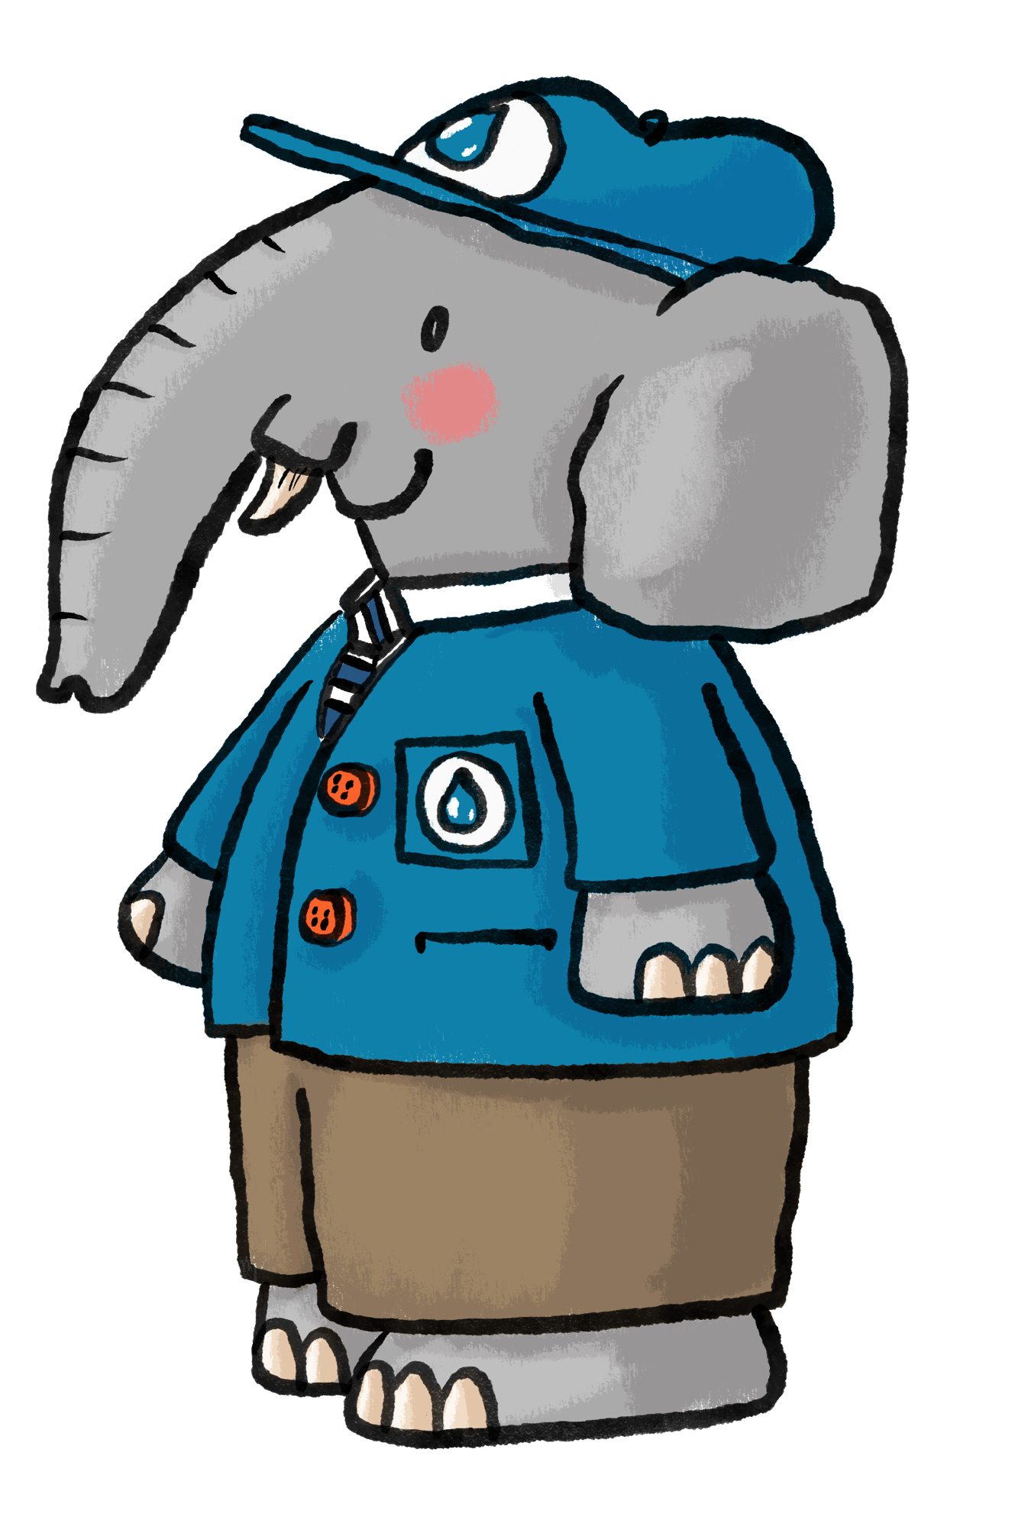
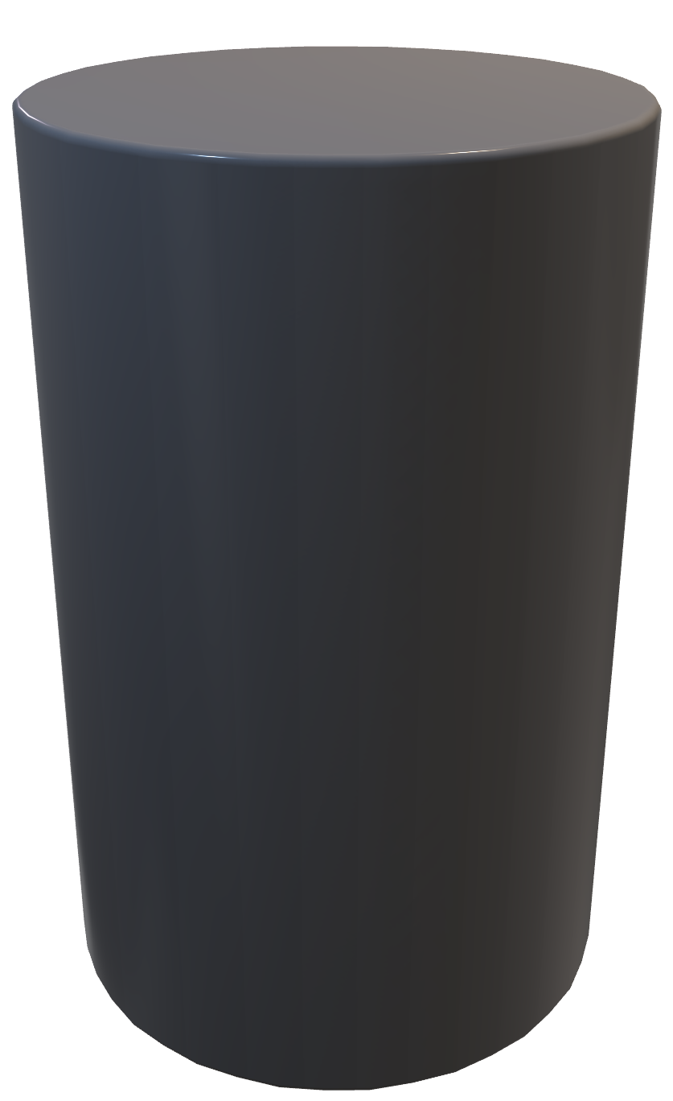
Cylinders
There are lots of cylinder shapes in a steam engine.
The boiler is a cylinder shape.
The pipes are long cylinders.
The piston moves inside a cylinder.
What properties does a cylinder have?
Notes:
Cylinders: Check children’s understanding. Talk about the properties of a cylinder. Show children a cylinder shape in the form of a toilet roll, glue stick etc. Cylinders have two identical flat circular faces (top and bottom), one curved surface connecting them, and two curved edges. It has no vertices (sharp corners).

Slide 15
Can you remember the engine process?
1
Steam enters the engine and pushes the piston inside a cylinder.
Fuel is burnt to heat a tank of water.
5
2
The water in the tank turns to steam.
6
The piston moves up and down.
3
The piston powers a plunger, pumping water to the reservoir.
A valve is opened to release the steam.
7
4
The steam travels to the engine through strong pipes.
The crank turns straight motion into ‘round and round’ motion.
8
Notes:
Encourage children to recall the steps in the engine process.

Slide 16
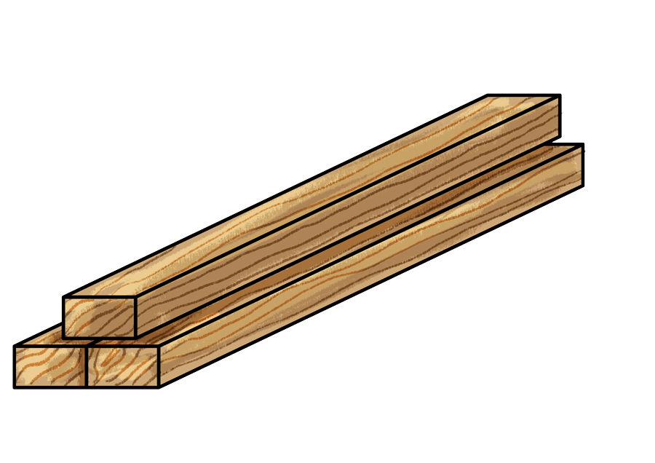
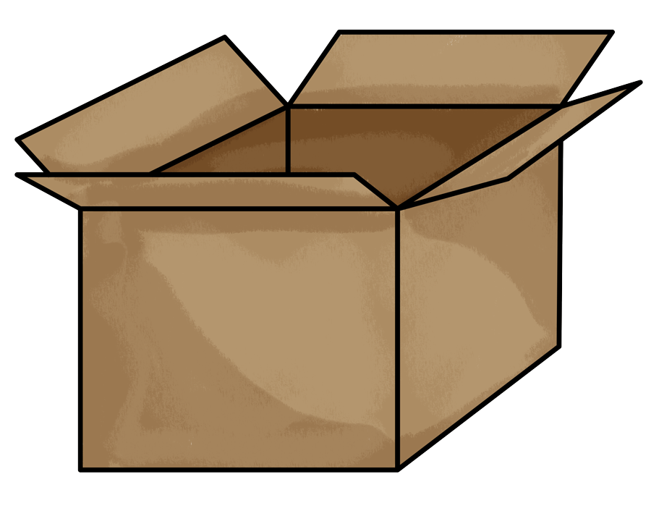
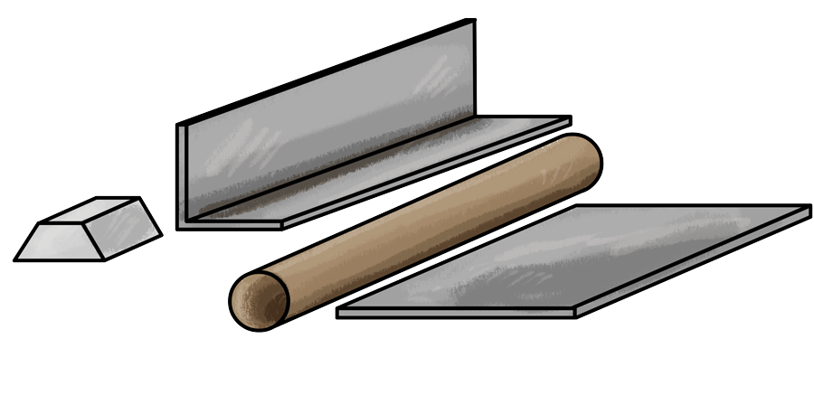
Imagine you are making a new engine to pump water.
What are the good and bad things about each material?
What material would you use?
wood
cardboard
metal
Notes:
Discuss the advantages and disadvantages of each material. Get children to think about strength, durability, moisture and recylability.

Slide 17

Design your own engine
These engine parts might help or make up your own ideas.
crank
pipes
valve
Notes:
Use the printable sheet or just plain paper to encourage children to design their own engine - what will it be used for, what will it be made from?
Model some really simple ideas on the board – try to be relaxed and imaginative, there are no right or wrong answers.

