Slide 1


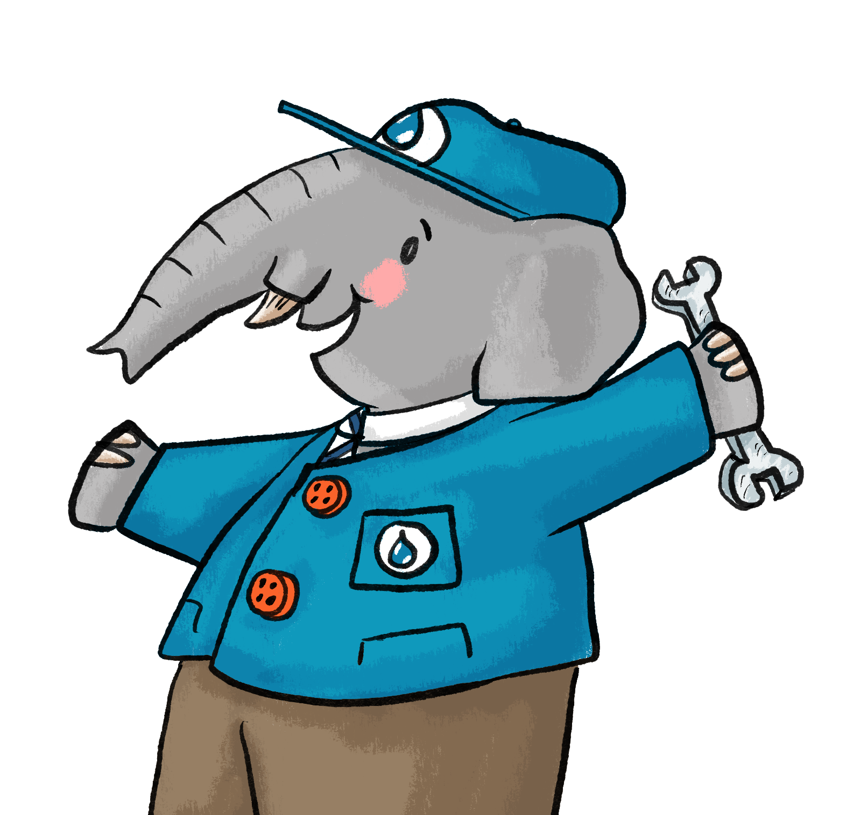

The Great Clean
Water Mission!
Clean Water for Life Resources © 2026
by Kempton Steam Museum are licensed under CC BY 4.0
KS1

Slide 2

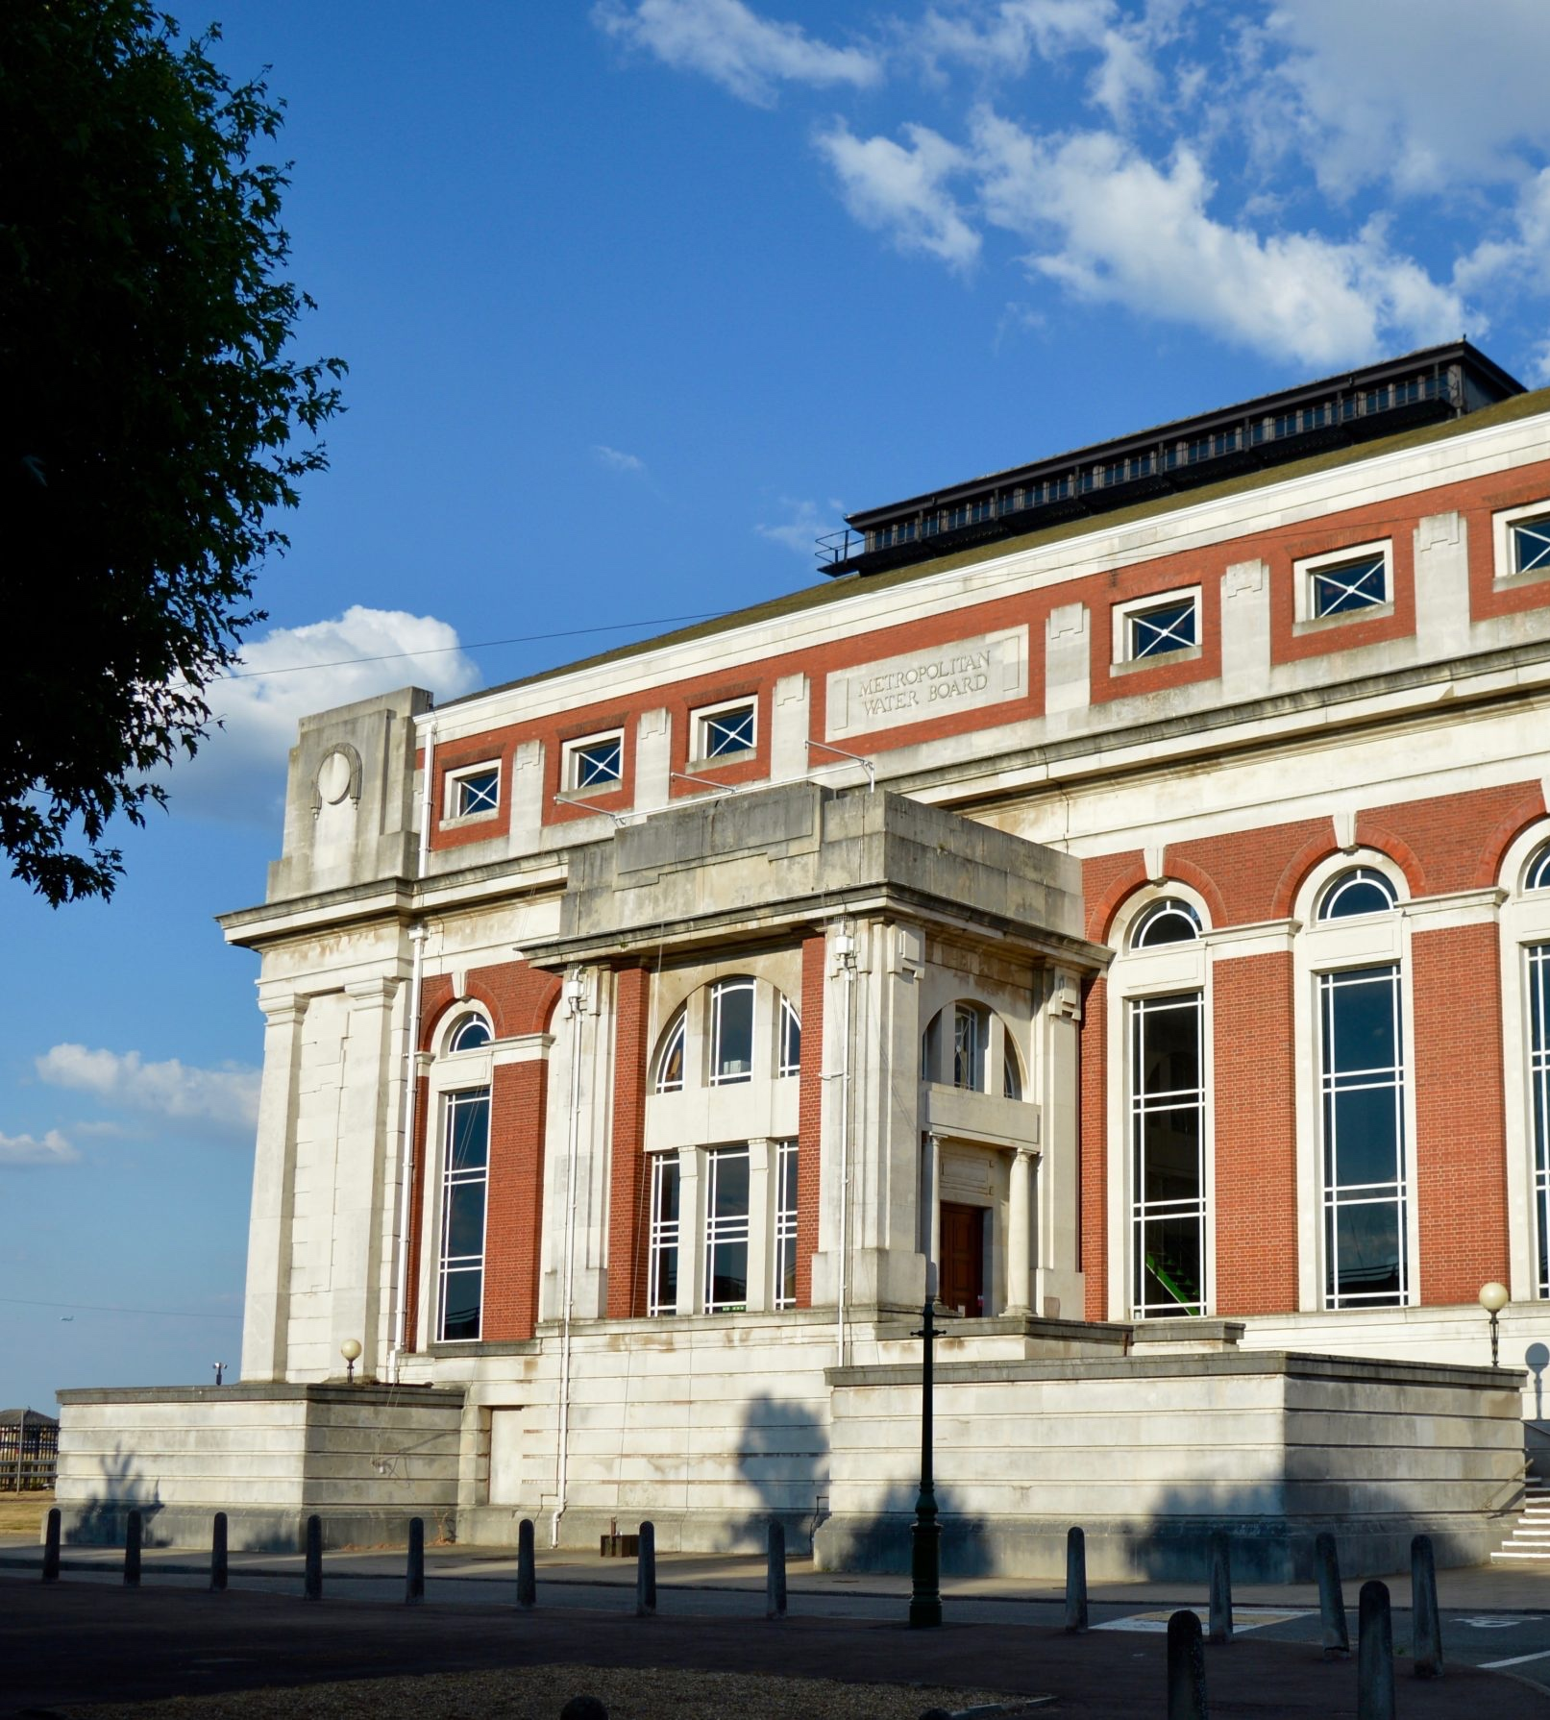
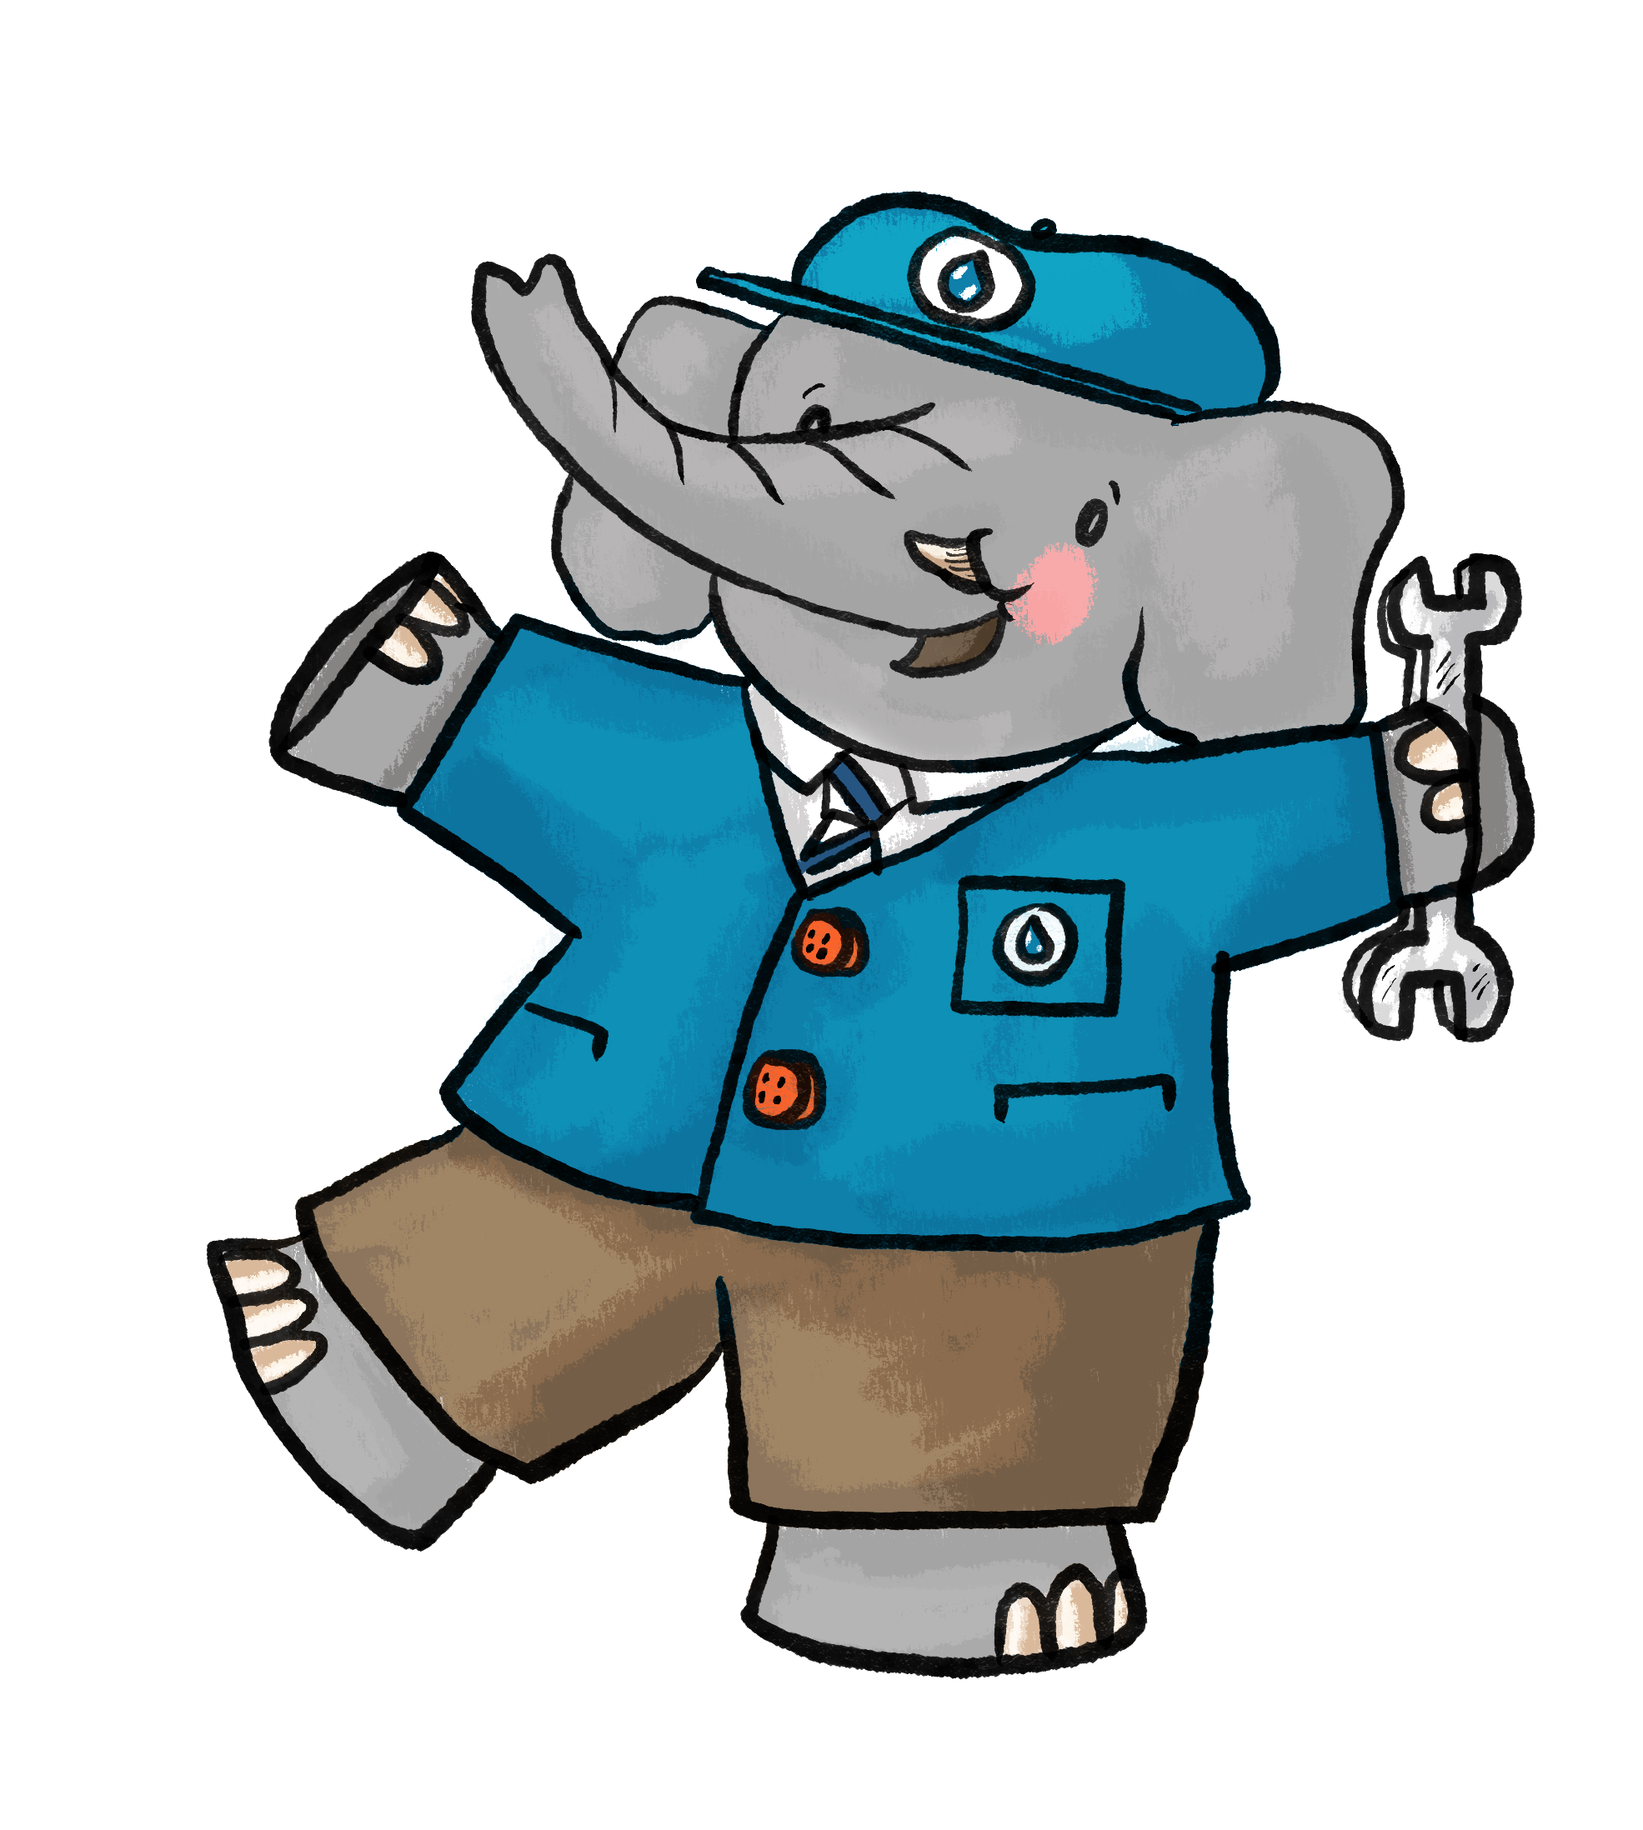
Meet Prescott
I’m Prescott, an Apprentice Engineer
at Kempton Steam Museum
Meet Prescott!
Wave your arm like a trunk to say hello.
It’s going to come in handy!
Notes:
Prescott is named after our No.6 Triple-Expansion Steam Engine ‘The Sir William Prescott’. Prescott features throughout our resources.

Slide 3

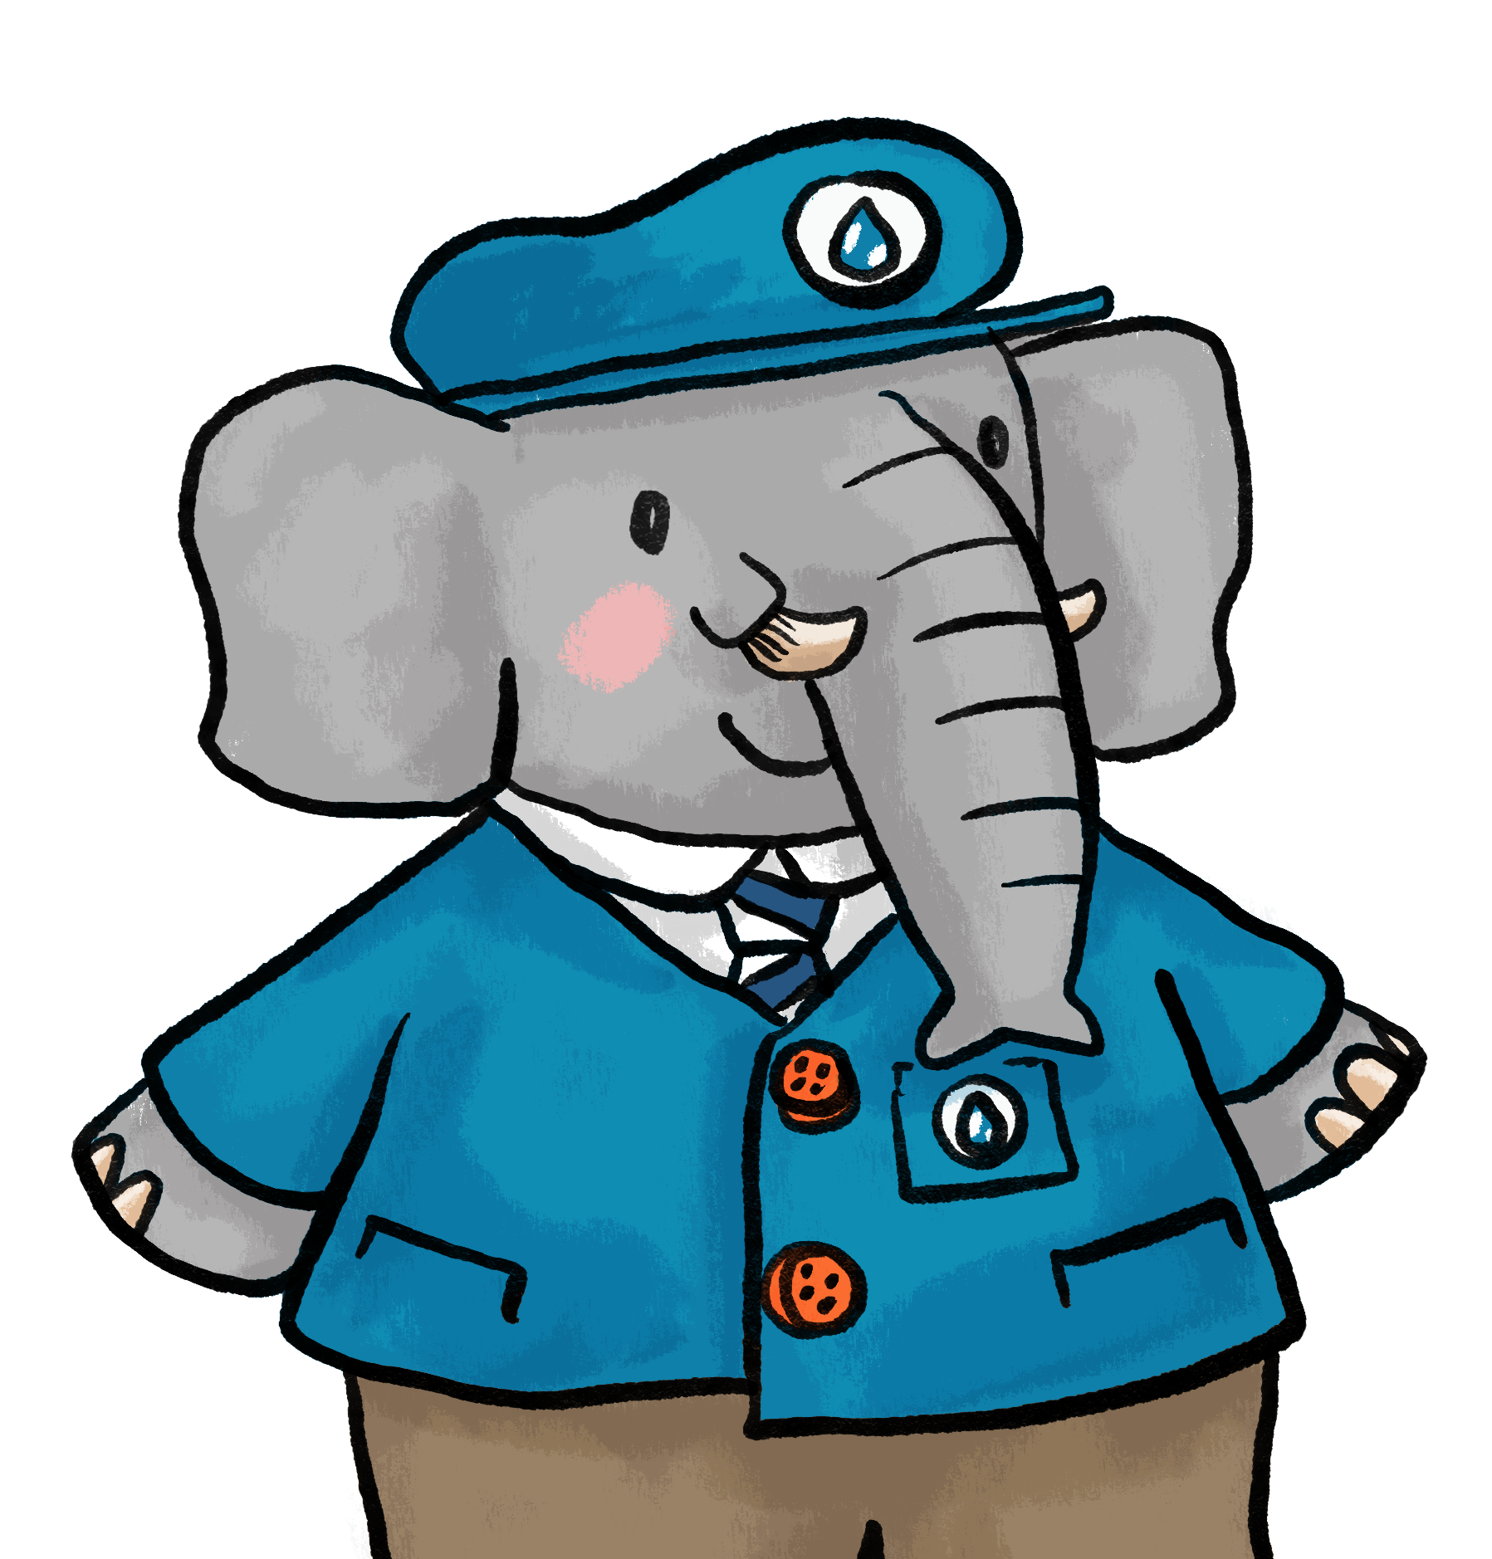
A letter from
London!
There’s an urgent message from London…
We need more clean water!
I need a team of
problem-solvers to help me.
Notes:
Set the seen for the lesson, children are problem solvers in the task.

Slide 4


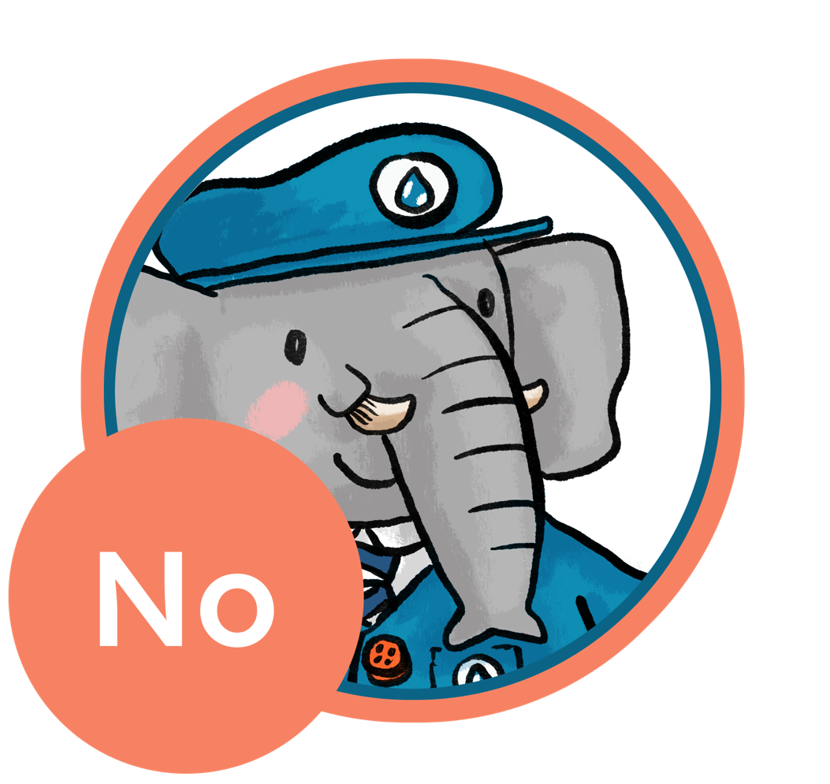
Question 1
Are you ready for the mission?
Try these quick questions to start...
Trunk up
for Yes
Trunk down for No
1. Do we need water to survive?
Notes:
Make this an active voting experience with trunks up for yes down for no.

Slide 5
1. Answer…
Yes, we need water to survive.
What else do we need?
Notes:
Yes, all animals need water including humans. Discuss what else we need to survive like shelter and food.

Slide 6
Question 2
Trunk up for Yes – Trunk down for No
2. Is water a solid?
Notes:
Active voting with trunks up for yes down for no.

Slide 7
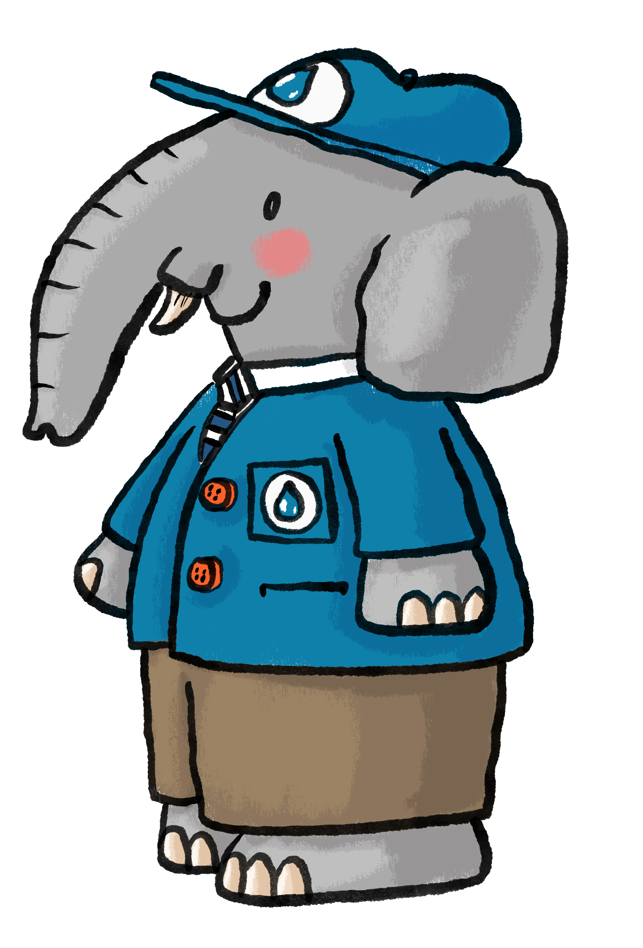
2. Answer…
Water is a liquid.
How could we turn water into a solid?
Did you know that water can change into a gas?
Notes:
Water is a liquid, discuss – How could we turn water into a solid? and explain that we can turn water into a gas by heating it up. Introduce the term ‘evaporation’.

Slide 8
Question 3
Trunk up for Yes – Trunk down for No
3. Are all types of water safe to drink?
Notes:
Final round of active voting.

Slide 9
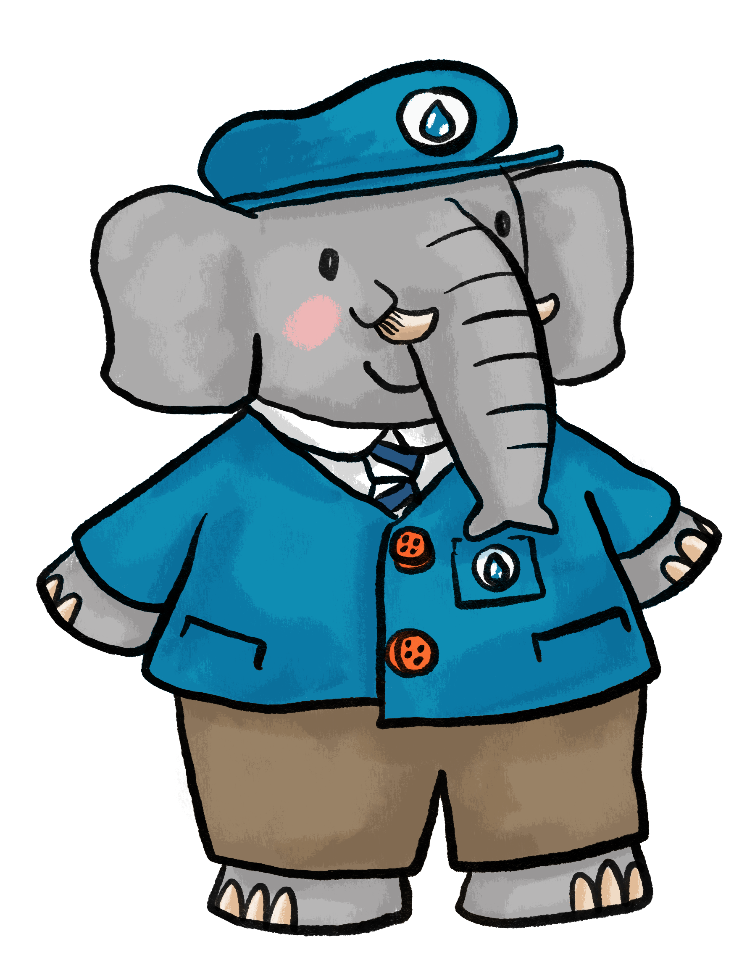
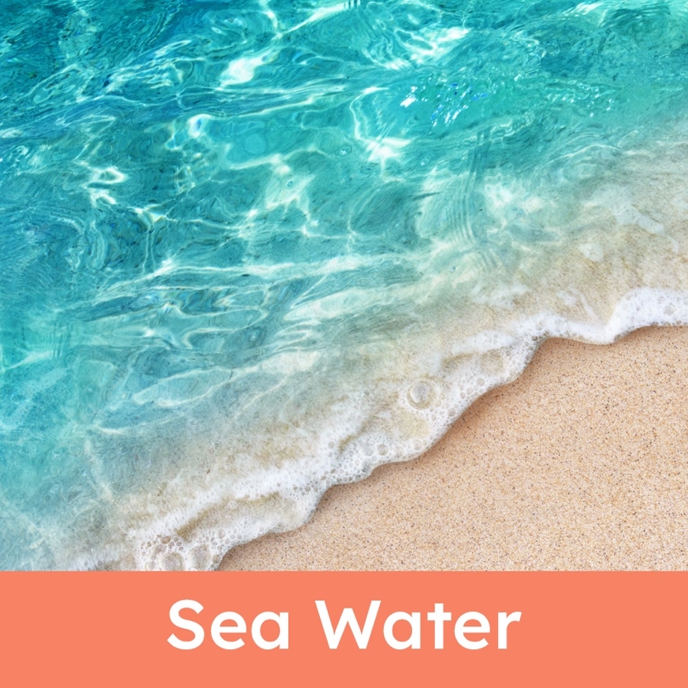
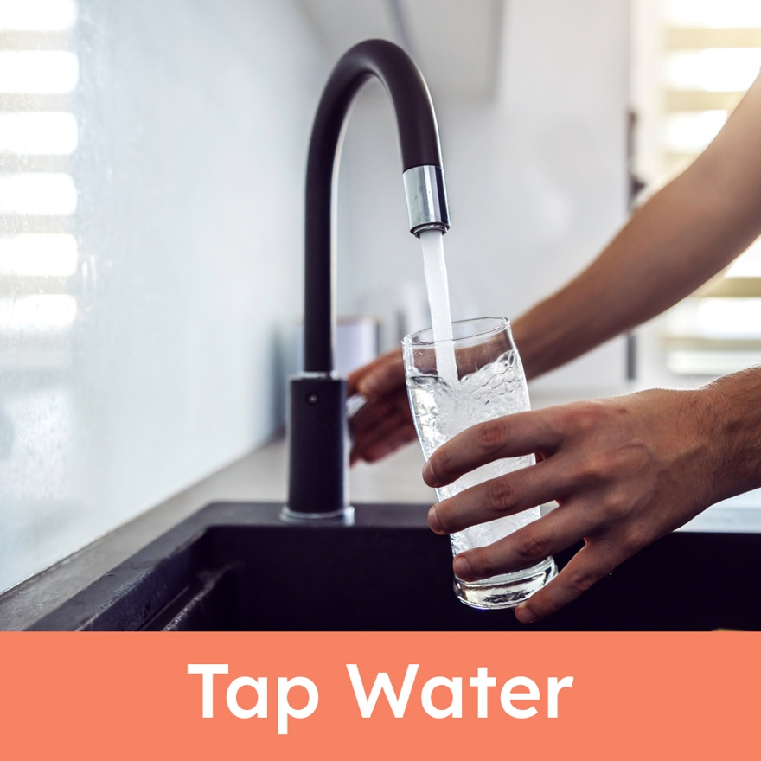
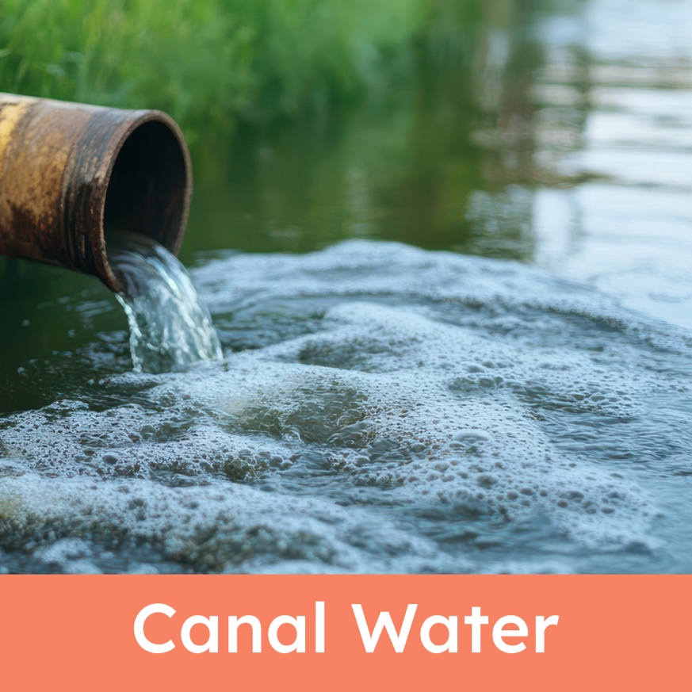
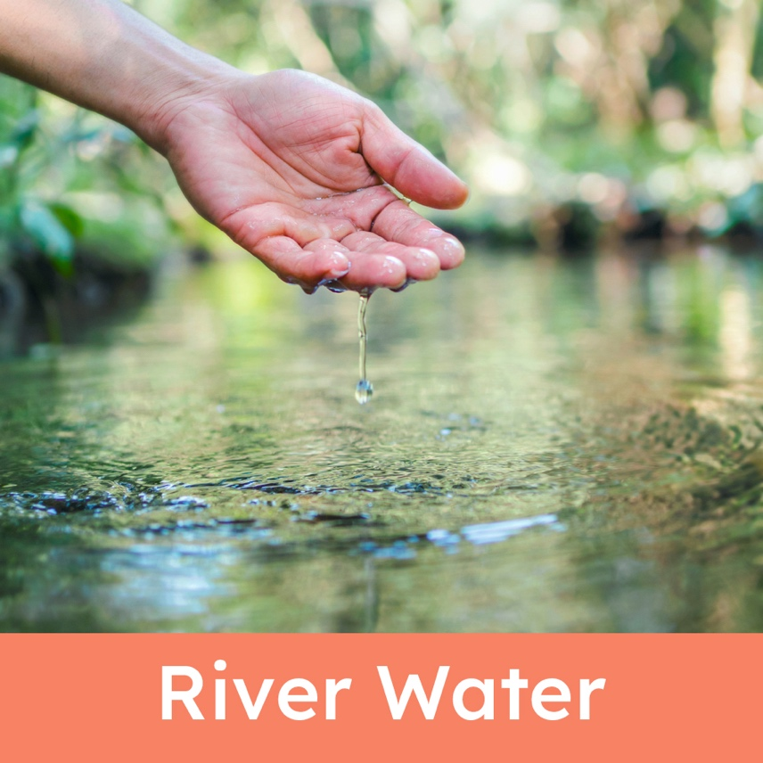
3. Answer…
Not all water is ok to drink.
Which of these types of water is safe to drink?
Notes:
Discuss how even water that looks clean or clear may not be safe to drink.

Slide 10
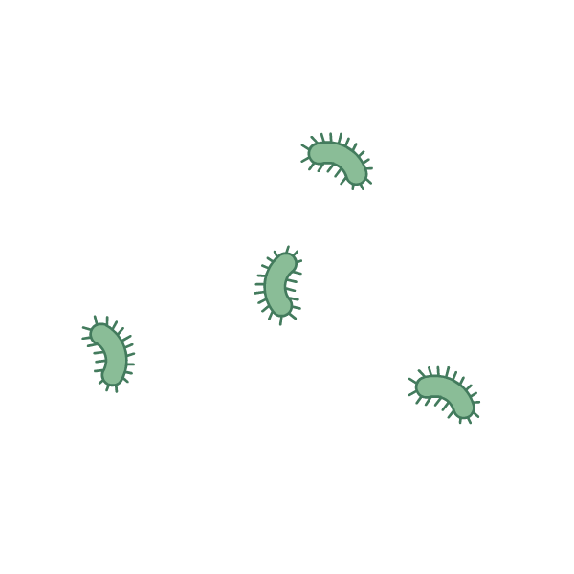
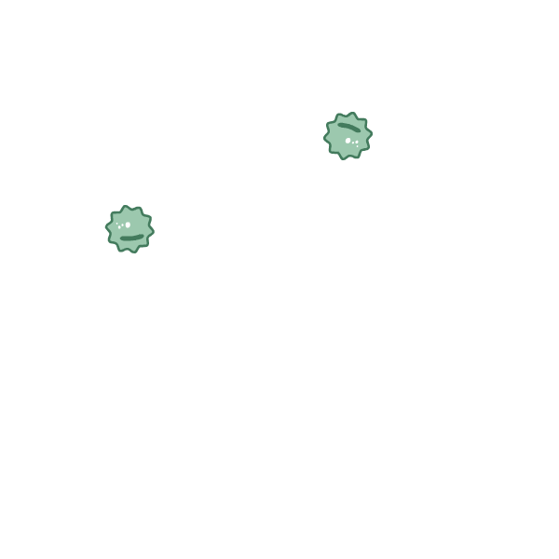
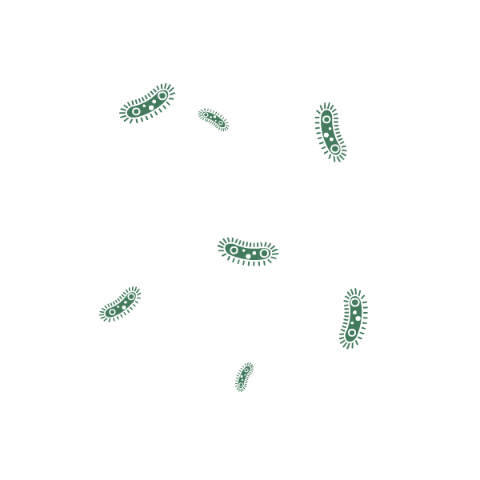
Understanding the problem
What might happen if we drink water with germs or dirt in it?
What do people use clean
water for?
How many ideas can you think of?
Notes:
Explain that drinking water with germs in can make us very unwell.
Discuss ways that we use water at home. Some children may be able to think of how businesses use water too – swimming pools, garden centres, cafés etc.

Slide 11
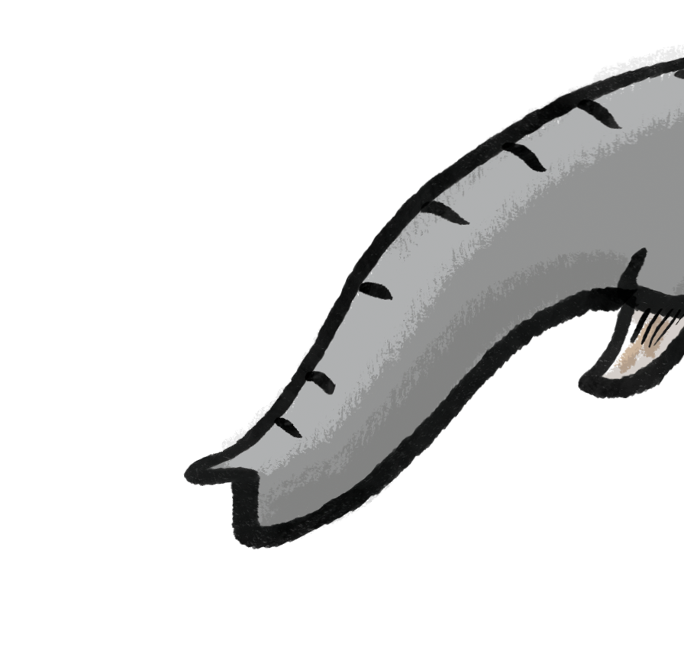
The museum is part of
Kempton Park Waterworks.
Kempton Park Waterworks has been supplying fresh, clean water to London since 1906.
What’s that blue wiggly line on the map?
Kempton
Park Waterworks
London
Water for London is taken
from the River Thames.
Notes:
Since 1906, Kempton Park Pumping Station has supplied fresh water to London. Originally powered by steam, it now uses electric motors – a shift similar to moving from petrol to electric vehicles.
The site remains essential for London’s clean water supply. The Trust preserves historic equipment and buildings, showcasing British industrial heritage and safeguarding endangered engineering skills.
Today, Thames Water PLC operates the site, which also houses the Kempton Great Engines Trust. The station filters water from the Queen Mary Reservoir, after extraction from the River Thames, then pumps it to Cricklewood’s service reservoir.

Slide 12

Cleaning water
How could we make the water clean?
Let’s think of some ideas.
Before we can pump the water to London, it needs
to be cleaned.
Notes:
Encourage children to think of their own ideas for cleaning water.
Describe that ‘untreated’ water has not been cleaned and is not safe to drink yet.
The current process is first settlement, where dirt and debris sink to the bottom of the storage reservoir. Then the water goes through a rapid gravity filter using sand to remove larger solids, it’s then treated with ozone, next it’s the slow sand filtration process and is then finally treated with chlorine to kill remaining bacteria.

Slide 13
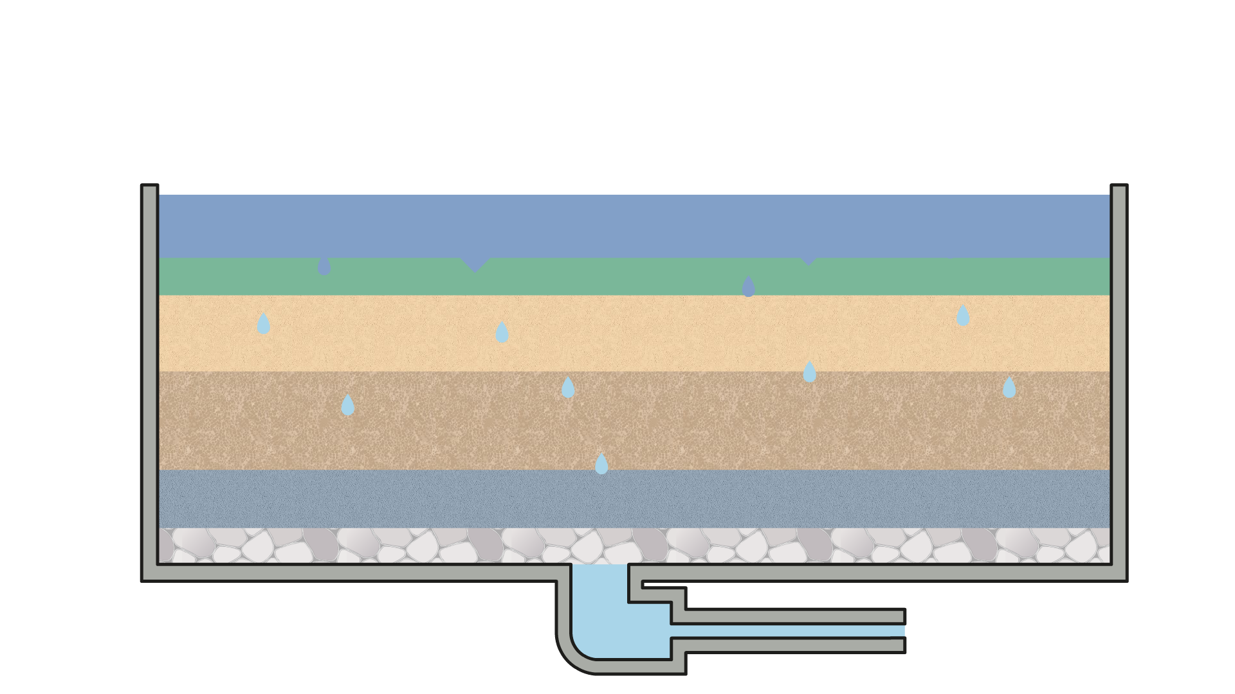
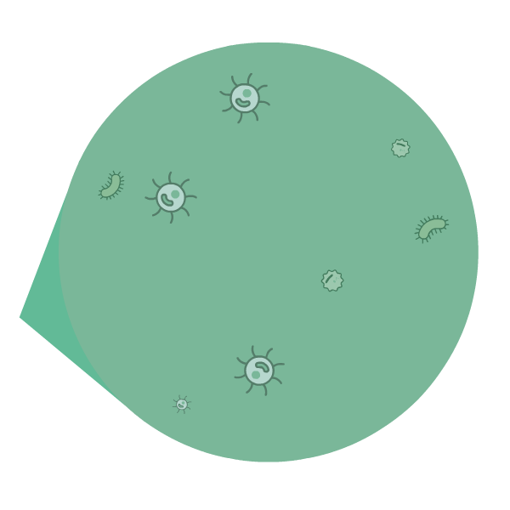
At Kempton, water is cleaned using a Slow Sand Filter.
A living ecosystem of good bacteria helps to get rid of germs.
Untreated water passes very slowly down through layers of sand and gravel to remove the dirt.
Clean water comes out through a pipe at the bottom.
Notes:
The top layer ‘living ecosystem’ layer is called the ‘schmutzdecke’. It forms on the surface of the fine sand. This layer consists of ‘good bacteria’ (live microorganisms that are not harmful to humans), fungi, algae, and protozoa that decompose organic matter and trap pathogens. The water then passes very slowly through the layers of sand and gravel trapping dirt along the way.

Slide 14
A filter experiment
Let’s try our own filtration experiment.
First, we gather the apparatus for the experiment.
We’ve chosen 3 types of filtration material
Experiment apparatus
Fabric and elastic bands to cover the spouts
3 x old plastic pop bottles cut in half
Jug
Water mixed with soil
Cotton wool
Sand
Gravel
Notes:
You may want to perform this experiment in the classroom as a ‘teacher experiment’ or simply follow the presentation slides. If experimenting in the classroom remind children not to drink any of the water, even after the filtration process. Bottles should be carefully cut in half beforehand and apply masking tape to edges if they are sharp. Other filter materials like pebbles or charcoal could be used. Cover the spouts of the bottles with lightly woven cotton or muslin cloth (secured with an elastic band) to allow water to pass through.

Slide 15
Which filter is best?
Which filter material will do the best job at cleaning this jug of dirty water?
Gravel, sand and
cotton wool
Sand
Sand and cotton wool
Which filter will make the water pass through more slowly?
Notes:
Ask children to predict which filter will work best. Ask children why do we want the water to move through the filter slowly? Talk about how to make the experiment a fair test (same amount of water, same type of fabric to cover the spout).

Slide 16

Experiment results
DO NOT drink the water!
Which filter gave the best results?
Sand, gravel and
cotton wool
Sand
Sand and cotton wool
Do you think this water is ready for London?
How could we make the water cleaner?
Notes:
Did they guess correctly? Encourage children to think about how they could improve the filtration process (pass the water through again, use different types of sand).

Slide 17
My Water Diary
Keep a water diary for 1 day
 |  | Water use category
Time | Description | Drinking | Flushing | Cooking | Washing (hands & body) | Cleaning | Other
7am | Flushed the toilet
7am | Washed my hands and face
7.30am | Glass of water
8.00am | Cleaned teeth
10.30am | Flushed the toilet
10.30am | Washed my hands
12.30pm | Glass of water
Notes:
This slide can be used to demonstrate how to complete the printable ‘My Water Diary’ (this could be a home/family task). The results printout can be used to help children to convert their water diary into a bar chart.

