Slide 1
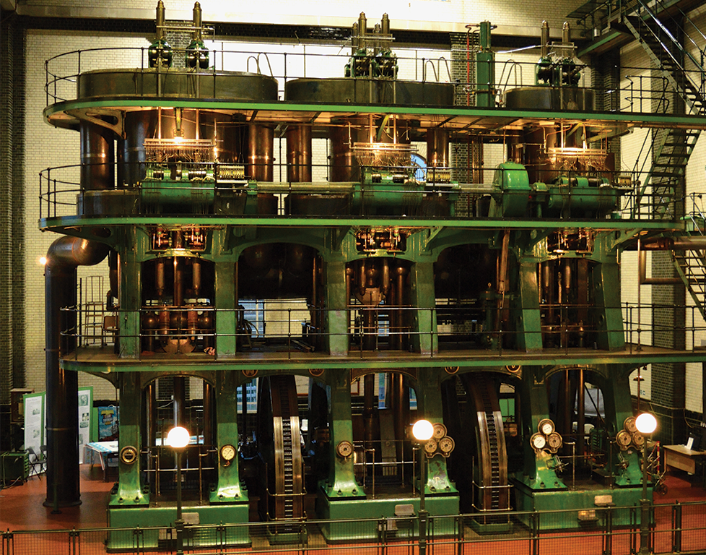


Under Pressure:
Steam Powered
KS2
Clean Water for Life Resources © 2026
by Kempton Steam Museum are licensed under CC BY 4.0

Slide 2




When water is heated, the water particles gain energy and start to move around really fast.
At 100°C, the particles break free of their bonds and escape into the air as a gas.
What is steam?
Boiling
= 100 °C
Notes:
Remind children that water boils at 100°C.

Slide 3

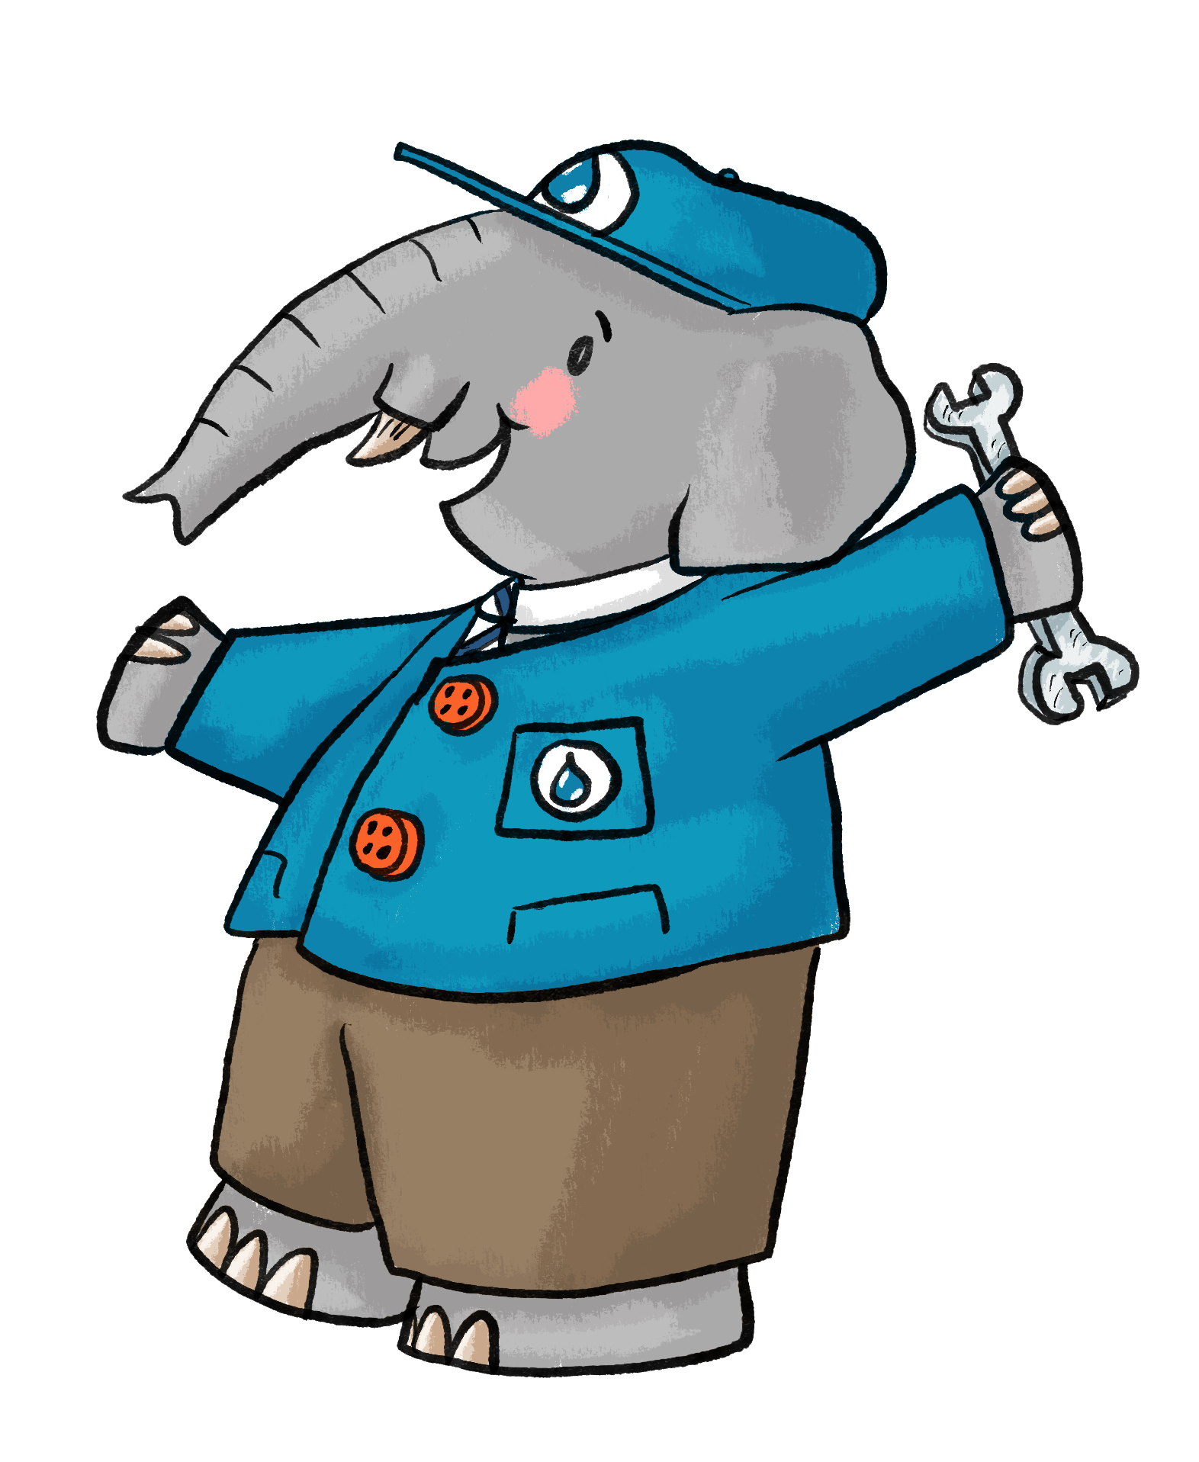
What is steam pressure?
The particles hit and push on the container walls harder and more often.
If we trap this steam tightly in a container,
the heat, pressure and energy builds up inside.
Notes:
Discuss the idea of trapping steam in a container, consider discussing a bottle of fizzy drink. When it’s sealed and pressurised the bottle is firm.

Slide 4

The superpower of steam
That’s like a banana growing to the size of a skyscraper!
When water turns to steam it expands by about 1,600 times in size!
The fast expansion of trapped steam creates massive pressure capable of powering engines and turbines.
Notes:
Ensure children understand the term expansion. ‘Think of your tummy when you’ve eaten a really big dinner and your belt or waistband is really tight’.

Slide 5
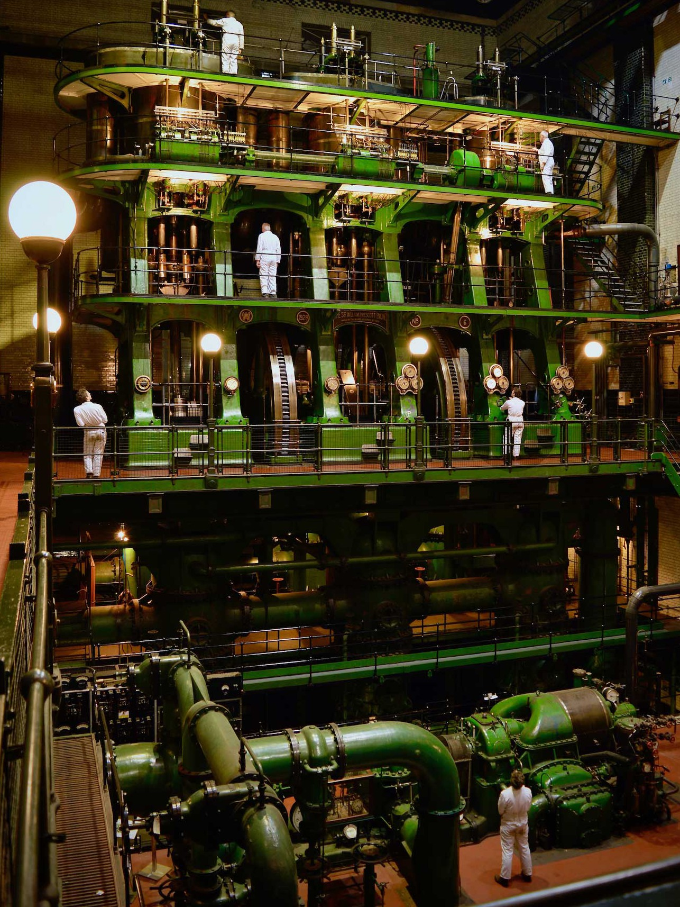
This is the Sir William Prescott Engine at Kempton Steam Museum.
It’s the largest working triple-expansion steam engine in the world!
It’s taller than 4 double decker buses!
It was used to pump clean water uphill to a reservoir.
It could pump 19 million litres
of water in a day!
That’s like pumping enough water to fill 127,000 bathtubs!
Notes:
The ‘Sir William Prescott’ and ‘Lady Bessie Prescott’ engines are inverted marine-type triple-expansion engines. They stand opposite each other in the Kempton Steam Museum. The engines were installed to each pump up to 19 million gallons of clean, drinking water per day to reservoirs in North London for the supply of fresh water to The City, Central, East and West London.

Slide 6
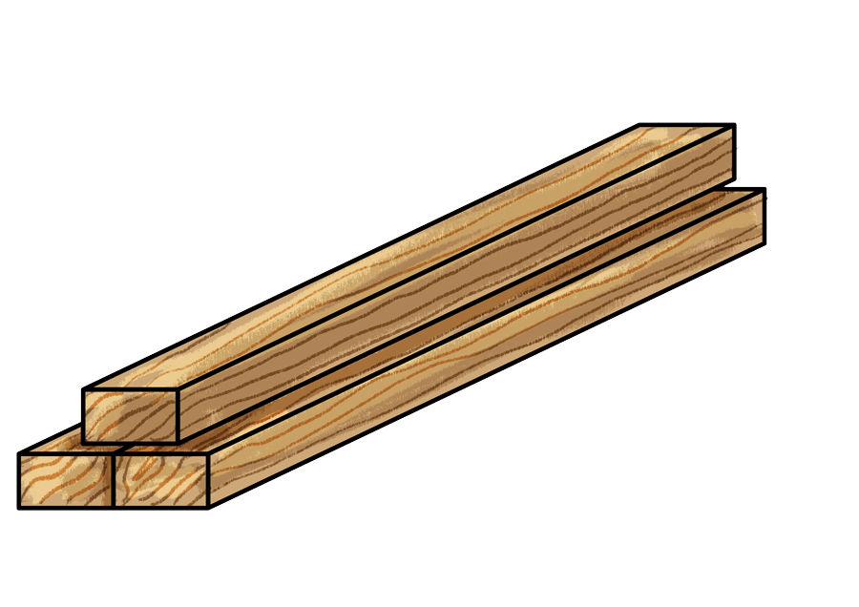
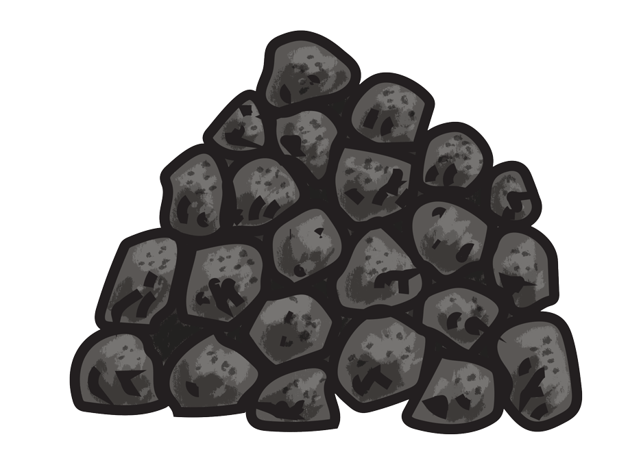
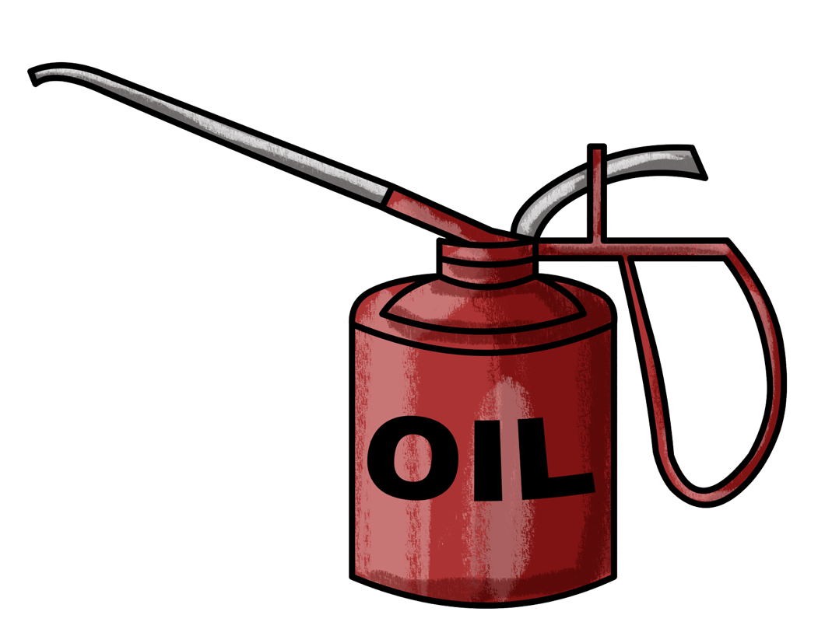
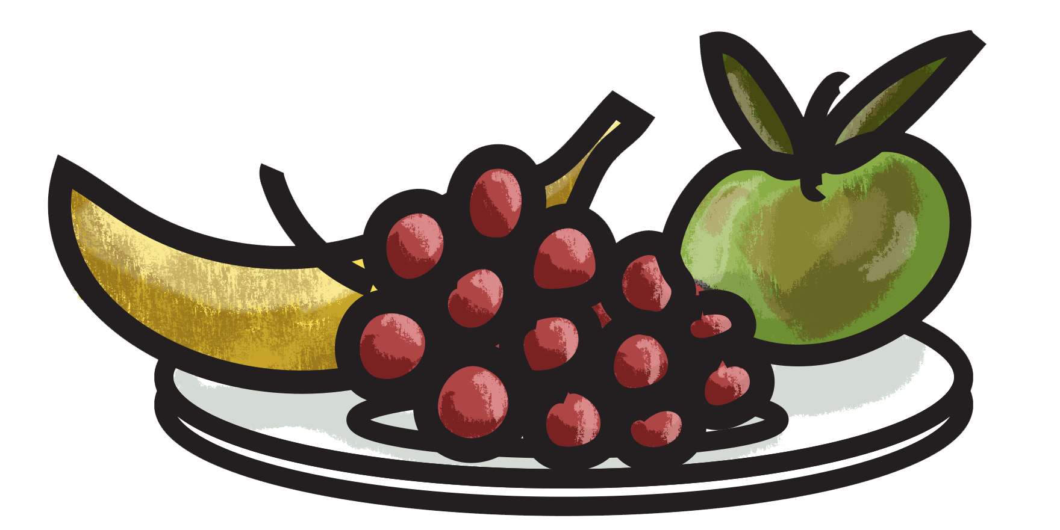
Just like us, engines need chemical energy to work.
When we
eat food, a
chemical reaction happens inside our body to give us energy.
Chemical energy is also stored in fuel like coal, oil, gas and wood.
Notes:
Chemical energy is a type of potential energy that’s stored in the bonds between atoms and molecules. Think of chemical energy as energy waiting to be used. Your body breaks down food molecules to get energy for moving and growing. It’s stored in things like wood, coal and even batteries.

Slide 7
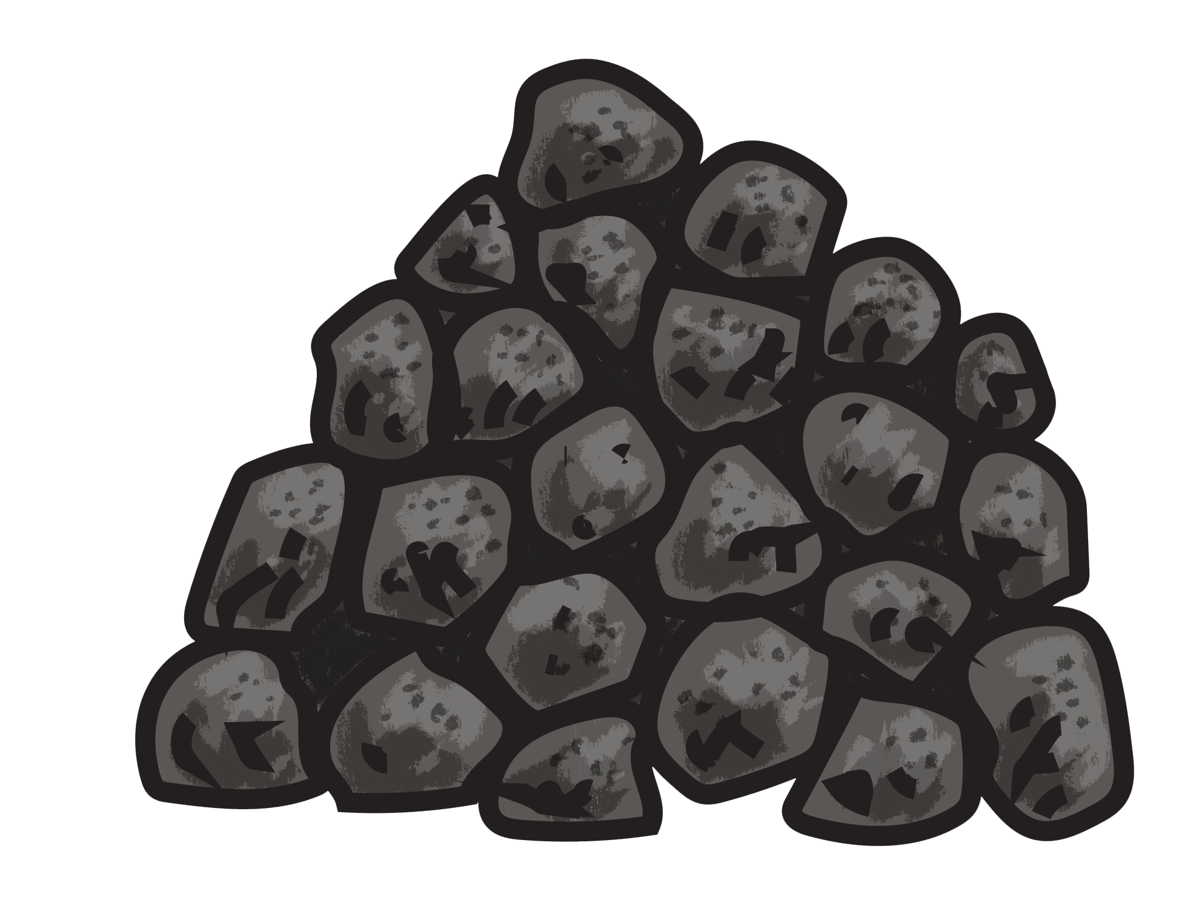
The engine was first powered by coal.
A LOT of fuel is needed
to run The Sir William Prescott Engine.
Coal was sent down enormous shoots like this, ready to be burnt.
Burning the fuel created the heat to make steam.
Nowadays the engine is
run by gas fuel.
What do you know about coal?
Notes:
At Kempton, coal fired boilers originally produced the steam. Steam is now generated by a small gas-fired boiler. We can control gas easier and we only run the engine on steaming weekends or special events to save fuel and energy. The benefits of natural gas over coal are lower carbon dioxide emissions, reduced air pollutants (fewer sulphur, nitrogen and particulate emissions) and higher thermal efficiency.
Coal is a fossil fuel - These natural resources formed from the remains of plants and animals that died millions of years ago. Oil and gas are also fossil fuels.

Slide 8
Making steam on a big scale!
To make enough steam to run the engine we use a huge boiler.
Boilers can be powered by different types of fuels.
The fuel creates heat to change water into steam.
Notes:
You could liken the steam engine boiler to a domestic boiler the pupils might have at home. Ask if they have to run the tap for a little while before the water gets warm. At Kempton Steam museum it takes us 3 days to start the engine; we have to turn the boiler on, check the pressure systems, check oil and lubrication etc. Remind children that a valve is like a door opening and closing, to stop steam, or to let steam out.

Slide 9
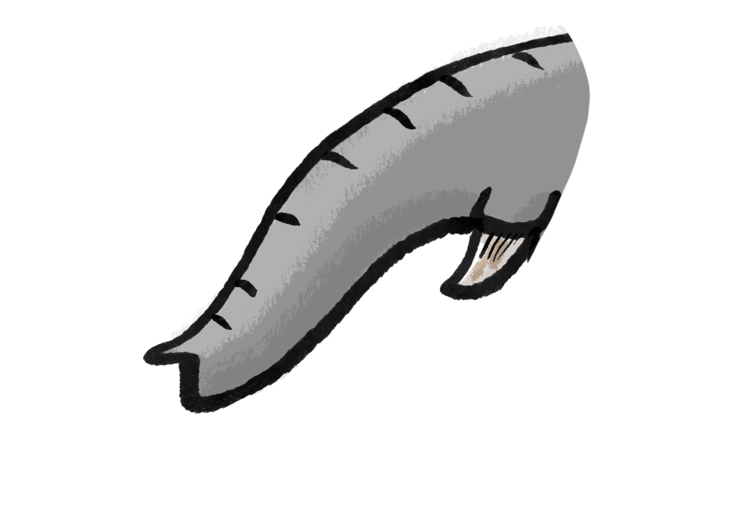
Inside an engine
Once the steam has travelled through the engine it goes out through the exhaust. It cools and condenses back into water.
The water is sent back to the boiler, where the process starts again.
cylinder
Steam engines have a cylinder with a piston inside.
steam in
exhaust
How many cylinders do you think a triple-expansion steam engine has?
A valve directs the steam from one end of the cylinder to
the other.
The piston is pushed up and down by the steam.
Notes:
Help children to identify the main engine parts; the cylinder, valve and piston. Remind pupils what a cylinder is. You could liken the piston inside the cylinder to a medicine syringe or a push-pop style lolly. You may like to focus in on the word ‘exhaust’ and ask: “How do you feel when you are exhausted? The steam has done a lot of work!”, “What noise do you make?”.

Slide 10
Triple-expansion steam engine
1
2
3
A triple-expansion steam engine has 3 cylinders.
The same steam is used 3 times before it is exhausted and condensed back into water.
Exhaust to condenser
The 3 cylinders makes the system much more efficient than a single cylinder engine.
What do you notice about the size of the cylinders and pistons?
Notes:
You could link the system to sustainability or recycling – “It’s a bit like using a yoghurt pot three times before you recycle it. Once for the yoghurt, then for paint pot, then for starting a seed and finally put in the recycling.”

Slide 11
Energy efficiency
1
2
3
As steam moves through each cylinder, the steam expands taking up more space but losing some of its pressure.
The cylinders and pistons are bigger at each stage to allow room for the expanded steam and to keep the force useful.
Exhaust to condenser
Cylinders and pistons get bigger.
High pressure
Intermediate (medium) pressure
Low pressure
Steam pressure reduces.
Notes:
Explain to pupils that energy efficiency is getting more useful work from the same energy. Discuss why it is important to use energy wisely.

Slide 12
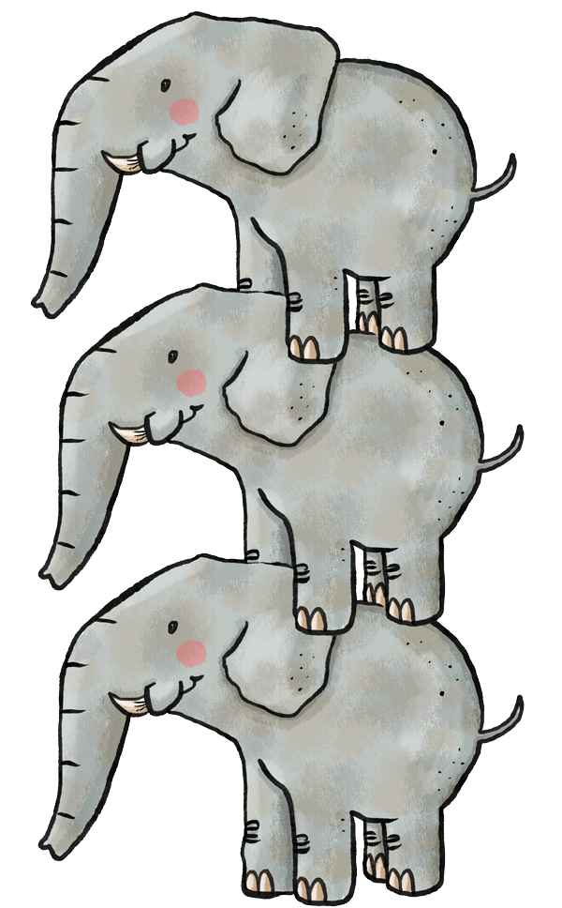
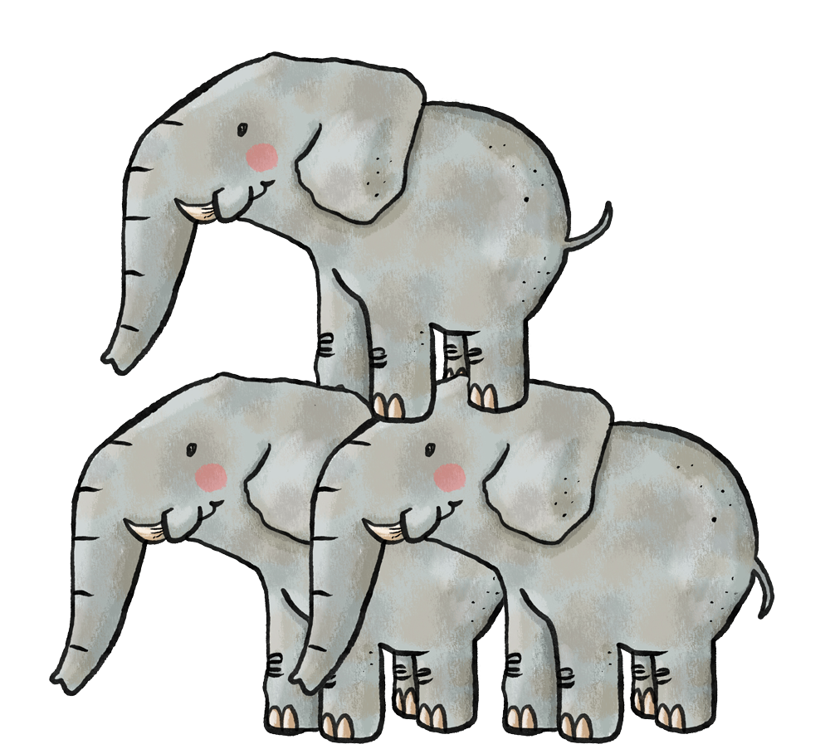
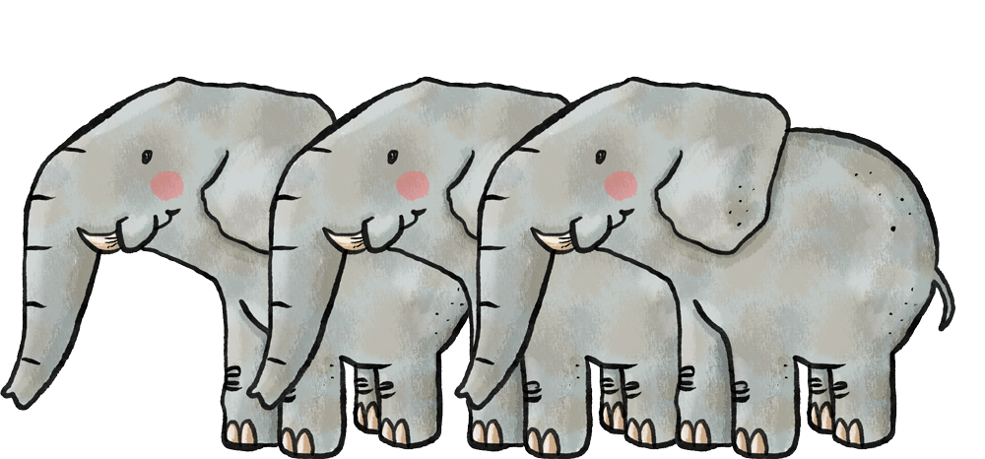
Different pressure: Same force
1
High pressure
2
Intermediate pressure
3
Low pressure
Small surface area
Larger surface area
Extra large surface area
Force = 500,000 N
Force = 500,000 N
Force = 500,000 N
Notes:
Force is measured in Newtons
Discuss the difference between pressure and force – Force is how strong the overall push is. Pressure is the effect of a force acting over a specific area. Children may be able to relate this to the pressure of car tyres.
Even though the pressure of the steam reduces, it can still apply the same amount of total force at each stage, because it’s pushing a piston
with a bigger surface area.
The engines were run at a boiler pressure of 200 pounds per square inch (psi). Compare this to an average car tyre pressure of around 30psi.

Slide 13
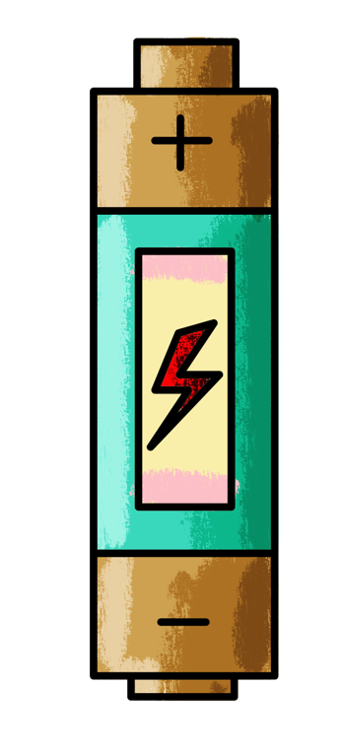
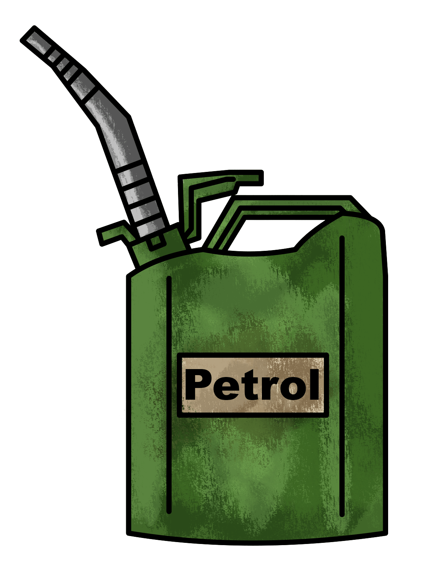
Imagine you are making a new engine to pump water.
What are the good and bad things about each?
How would you power the engine?
electricity
coal
petrol
Notes:
Use this as an opportunity to talk about electricity and fuel. There is chemical energy inside coal and petrol but it needs to be burnt. Batteries are used to store electrical energy. We can make electrical energy in lots of different ways, but it is generally considered a cleaner source of energy.
You could show children a piece of coal.
Depending on ability you may be able to discuss clean energy or renewable energy.
Clean energy is energy that comes from sources that do not pollute the environment. It helps to reduce the harmful effects on our planet and is better for our health. Some examples of clean energy sources are wind power, solar power, hydropower.
Renewable energy is energy that comes from sources that can be replenished naturally and are not depleted when used. This means that, unlike fossil fuels such as coal, oil, and natural gas, which can run out, renewable energy sources are always being produced. Here are some renewable energy sources: wind energy, solar energy, biomass (organic waste materials), tidal energy.

Slide 14

The triple expansion steam system
Can you guess the missing words?
The pistons move up and down inside the cylinders.
A valve directs the steam from one end of the cylinder to the other.
p_______?
v____?
Steam leaves the engine through the
exhaust
Steam is produced inside the boiler
e______?
b_____ ?
Steam is condensed
back into water and returns to the start of the process.
c________?
Water is heated
to make steam.
High pressure
cylinder.
Intermediate pressure cylinder.
Low pressure cylinder.
H___?
I__________?
L__?
h_____ ?
Notes:
Work together as a class to complete the missing words. This activity is also available as a printable activity.
Answers (starting at the boiler): heated – boiler – pistons – valve – exhaust – condensed – low – intermediate – high

